Slide 1

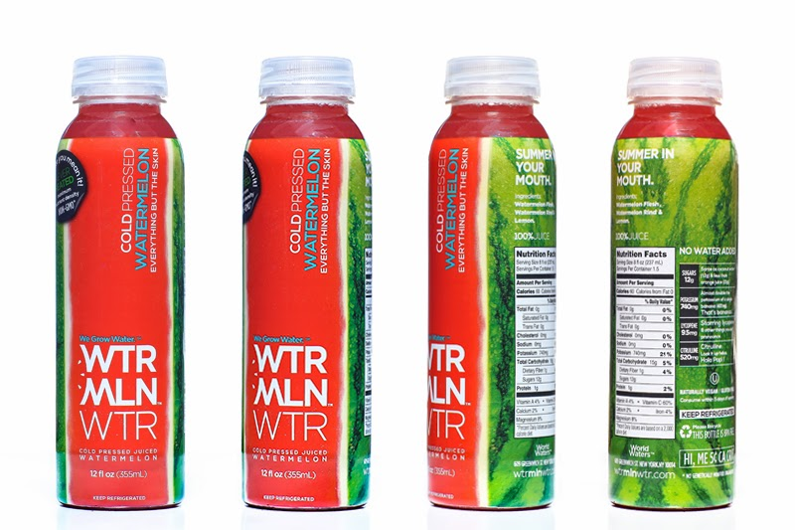
WTRMLN WTR
Pre visits for Costco Blitz
May 2015
Market Manager
Kelly Kalac

Slide 2
Northridge Costco
8810 Tampa Ave. Northridge, CA 91324
Mike Peppard w437mer@costco.com
Walk to the back of the store, Dairy coolers are on the left, here would be a great place to set up, putting products in the fridge. Further back is the Produce cooler. Around the side is where the juices are normally kept. Here is my second choice area for demoing, I found a Suja demo happening way in the back left corner of the store, lets not go back here.

Slide 3
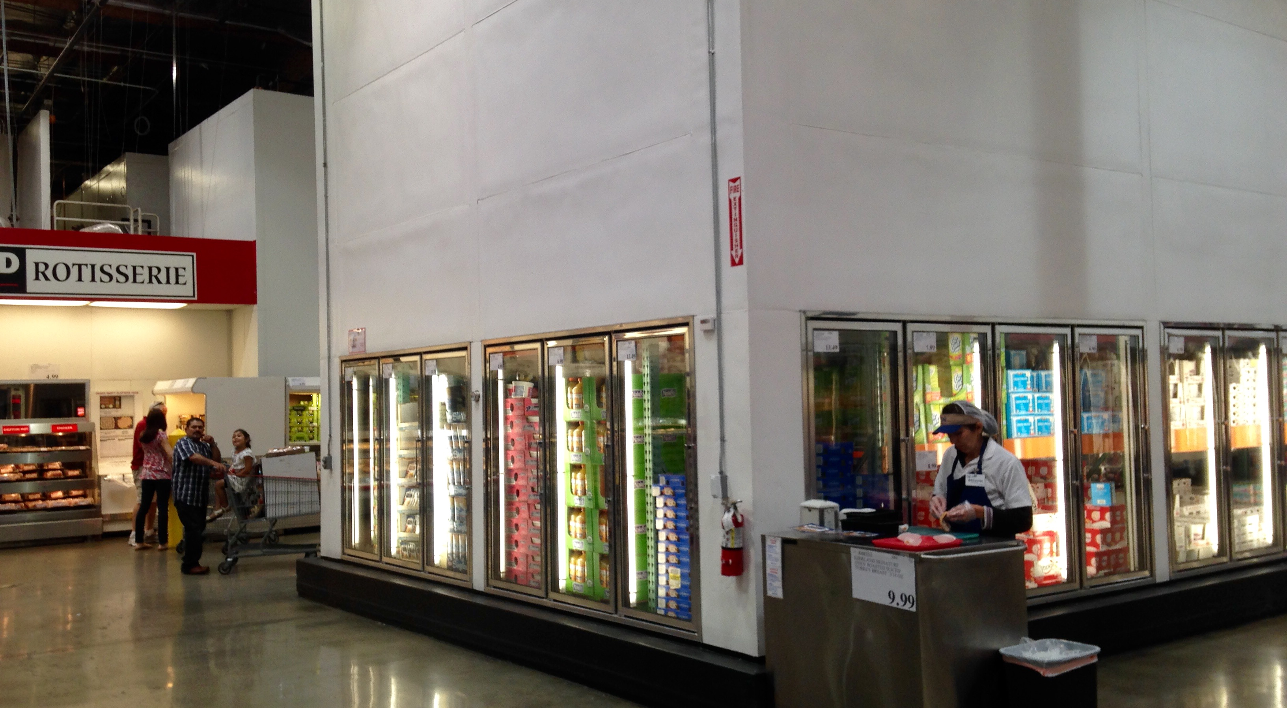
Northridge Costco

Slide 4
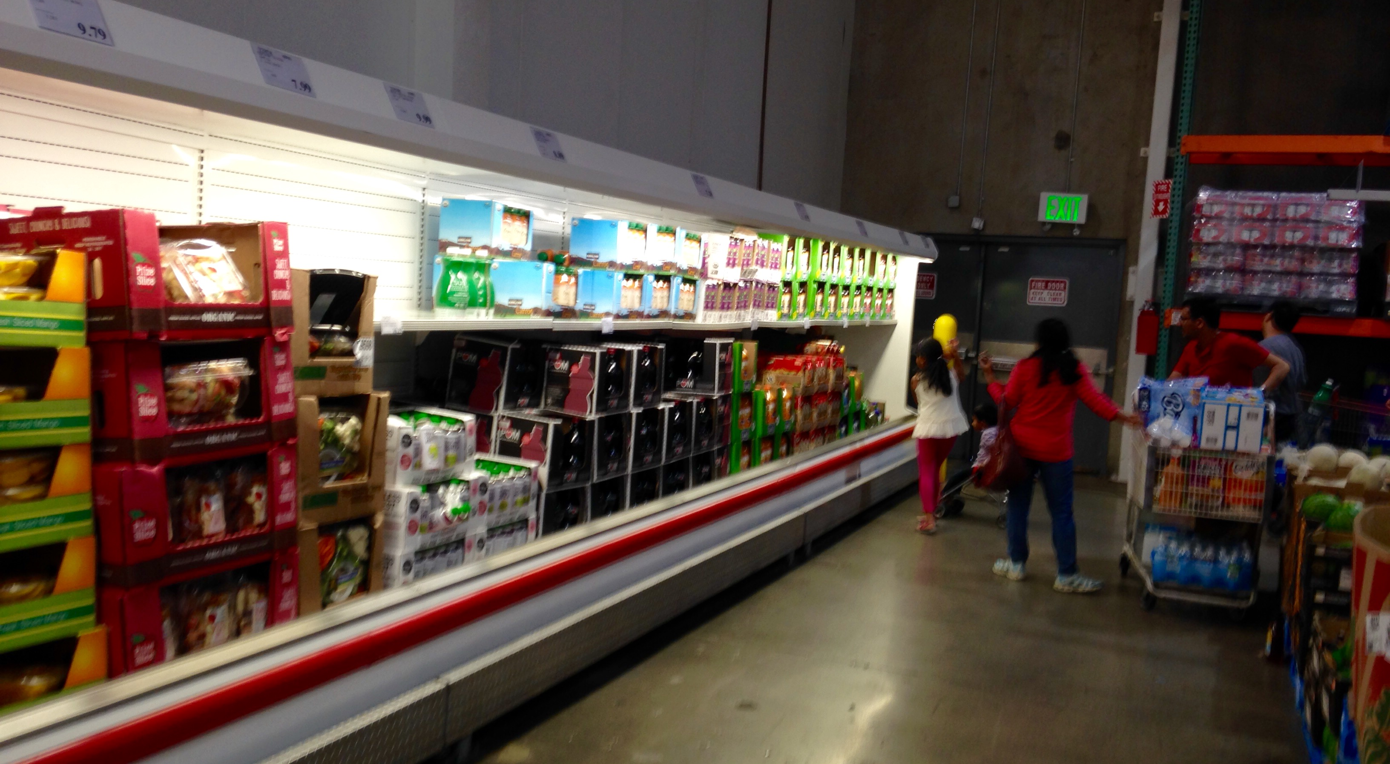
Northridge Costco

Slide 5
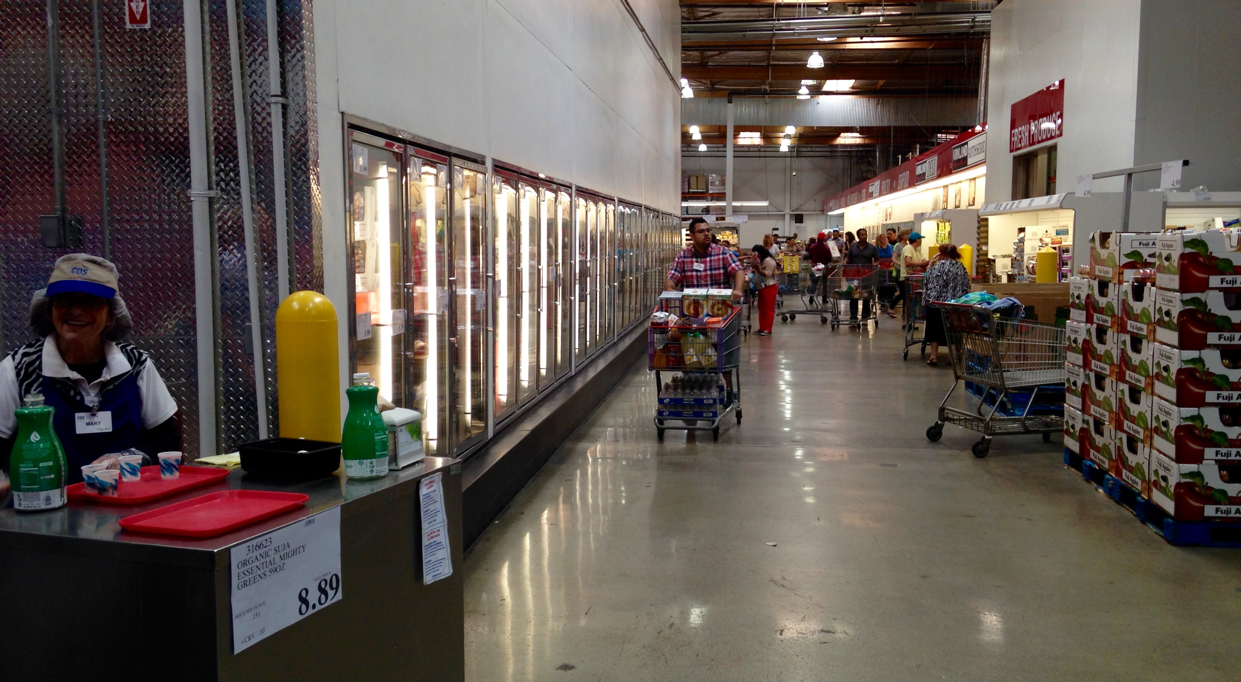
Northridge Costco

Slide 6
Canoga Park
21300 Roscoe Blvd. Canoga Park, CA 91304
Daniel Davenport w044mer@costco.com
Walk to the back of the store, Dairy coolers are on the left, here would be a great place to set up, putting products in the fridge near where the Naked juice is currently found. Further back is the Produce cooler. On the sides is where the juices are normally kept. Here is my second choice area for demoing, I found a Suja demo happening way in the back of the store. This is also a nice high traffic placement area.

Slide 7
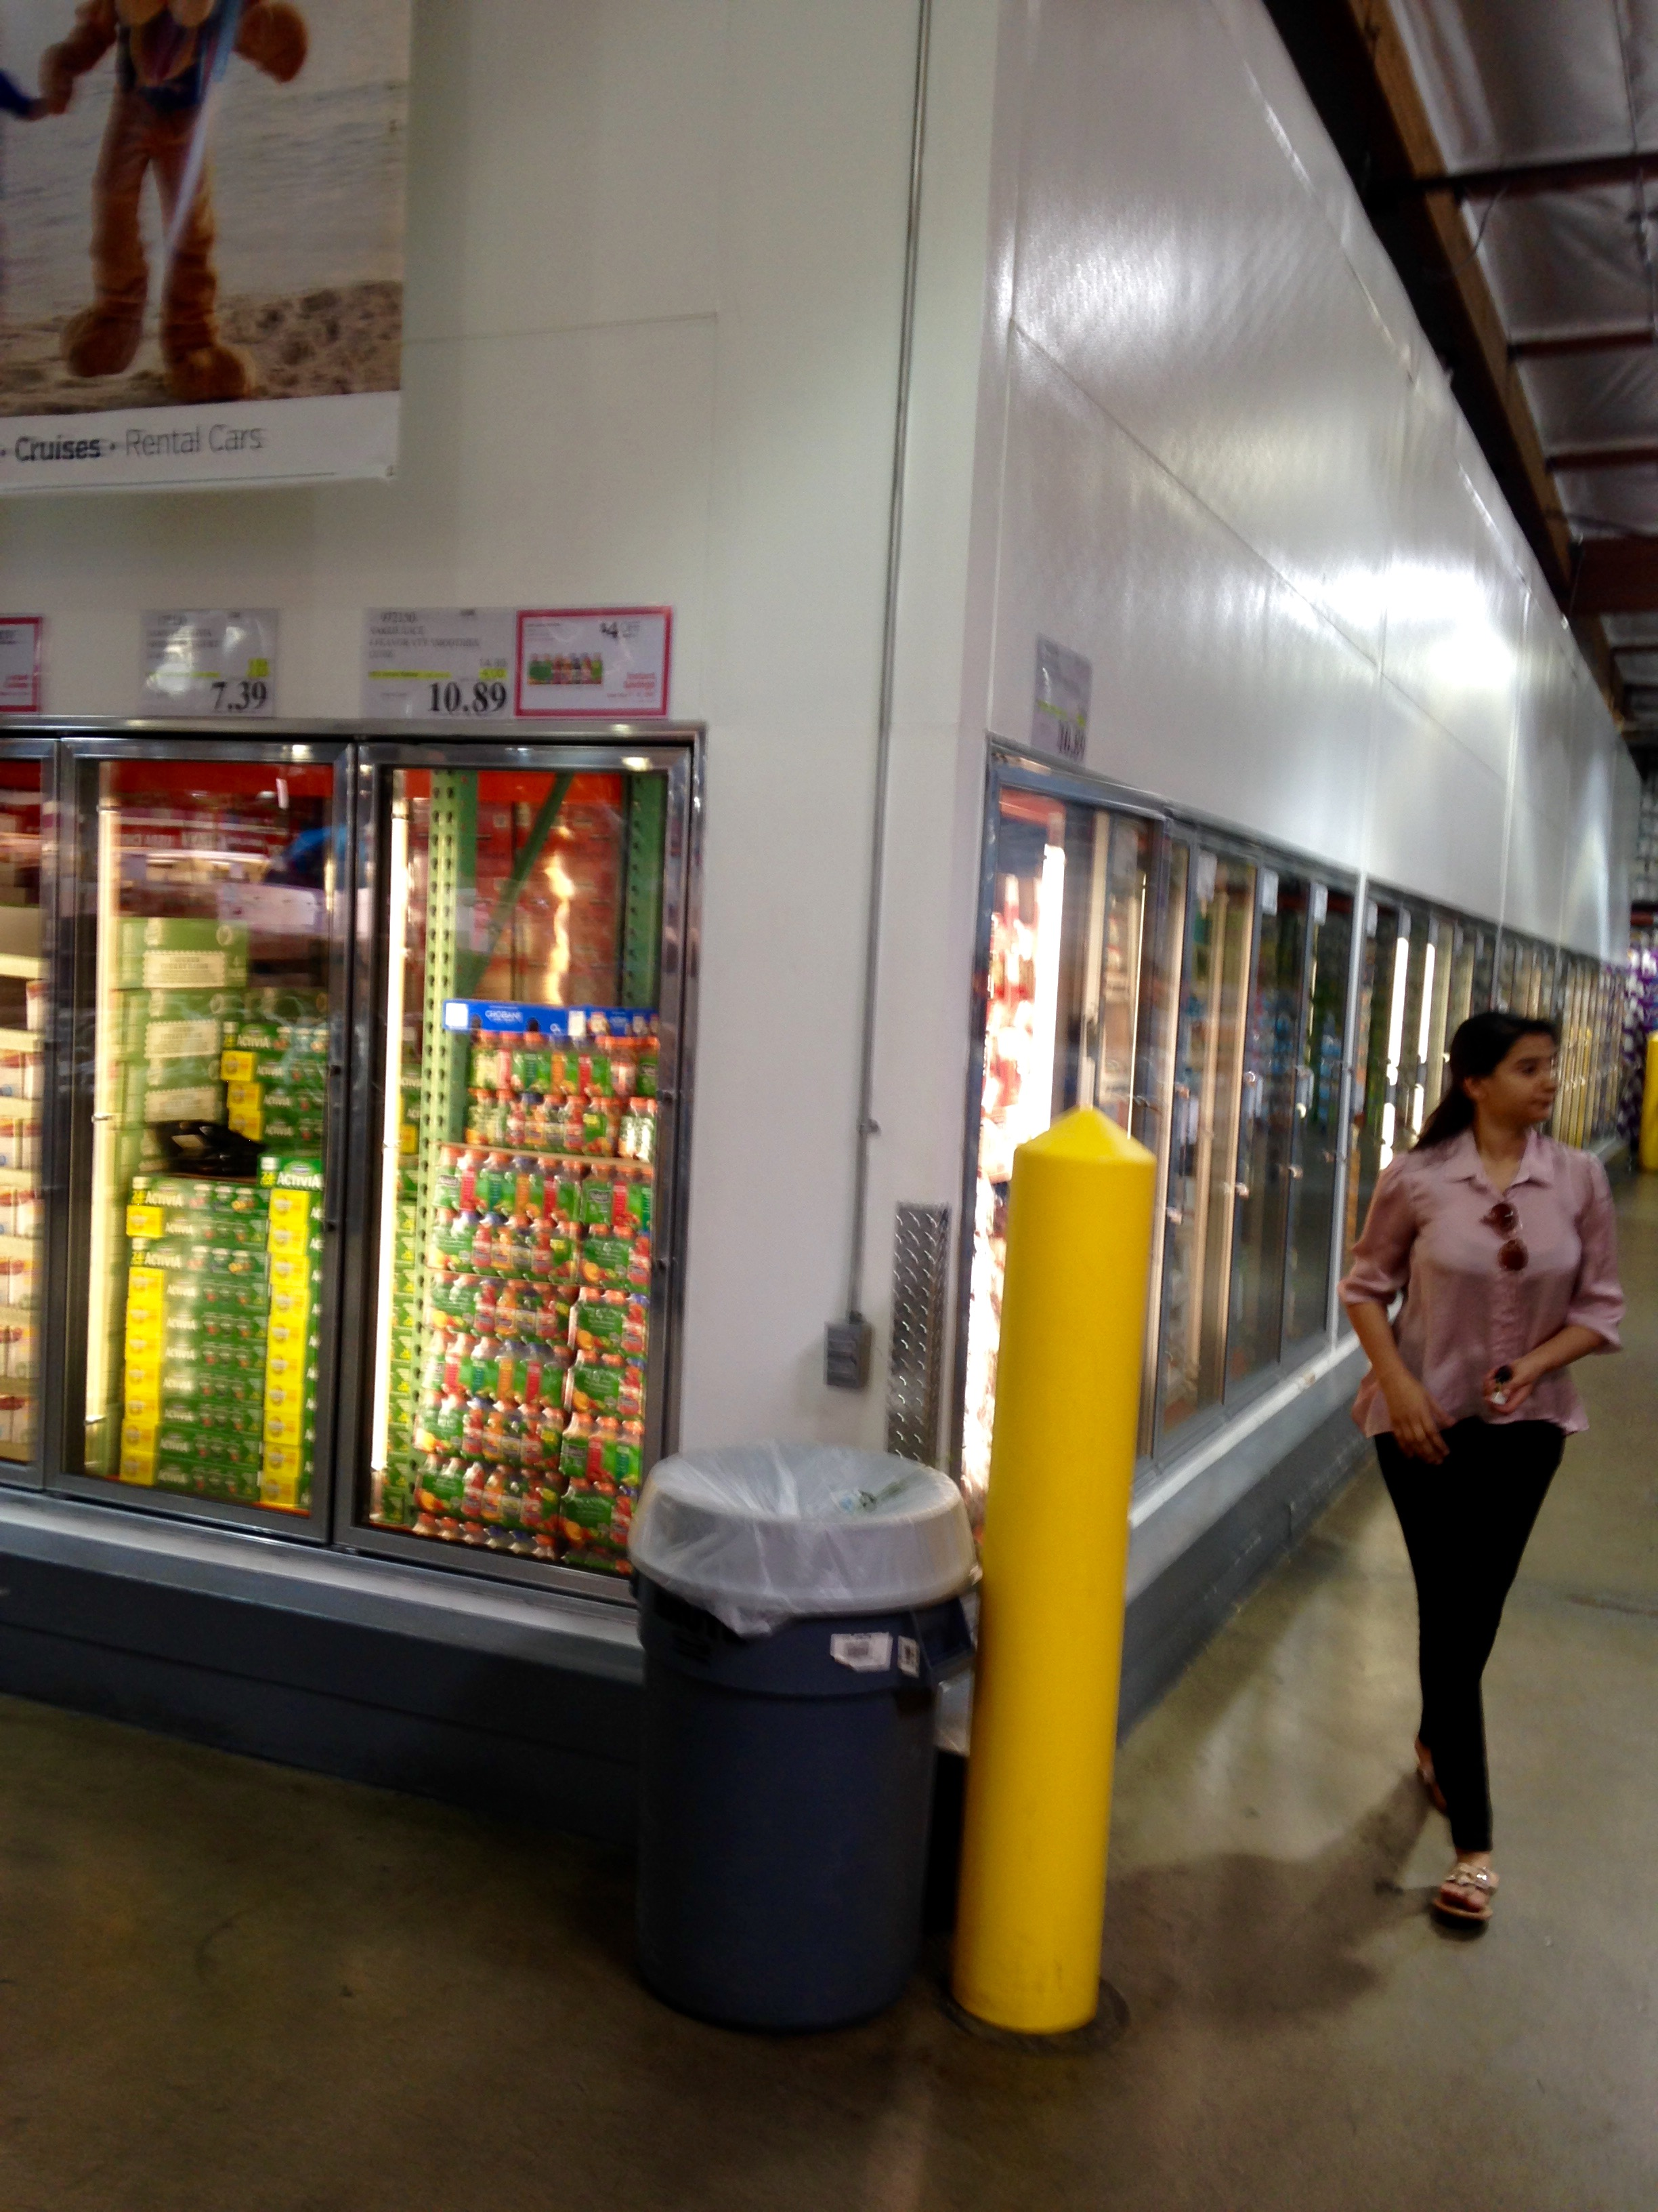
Canoga Park

Slide 8
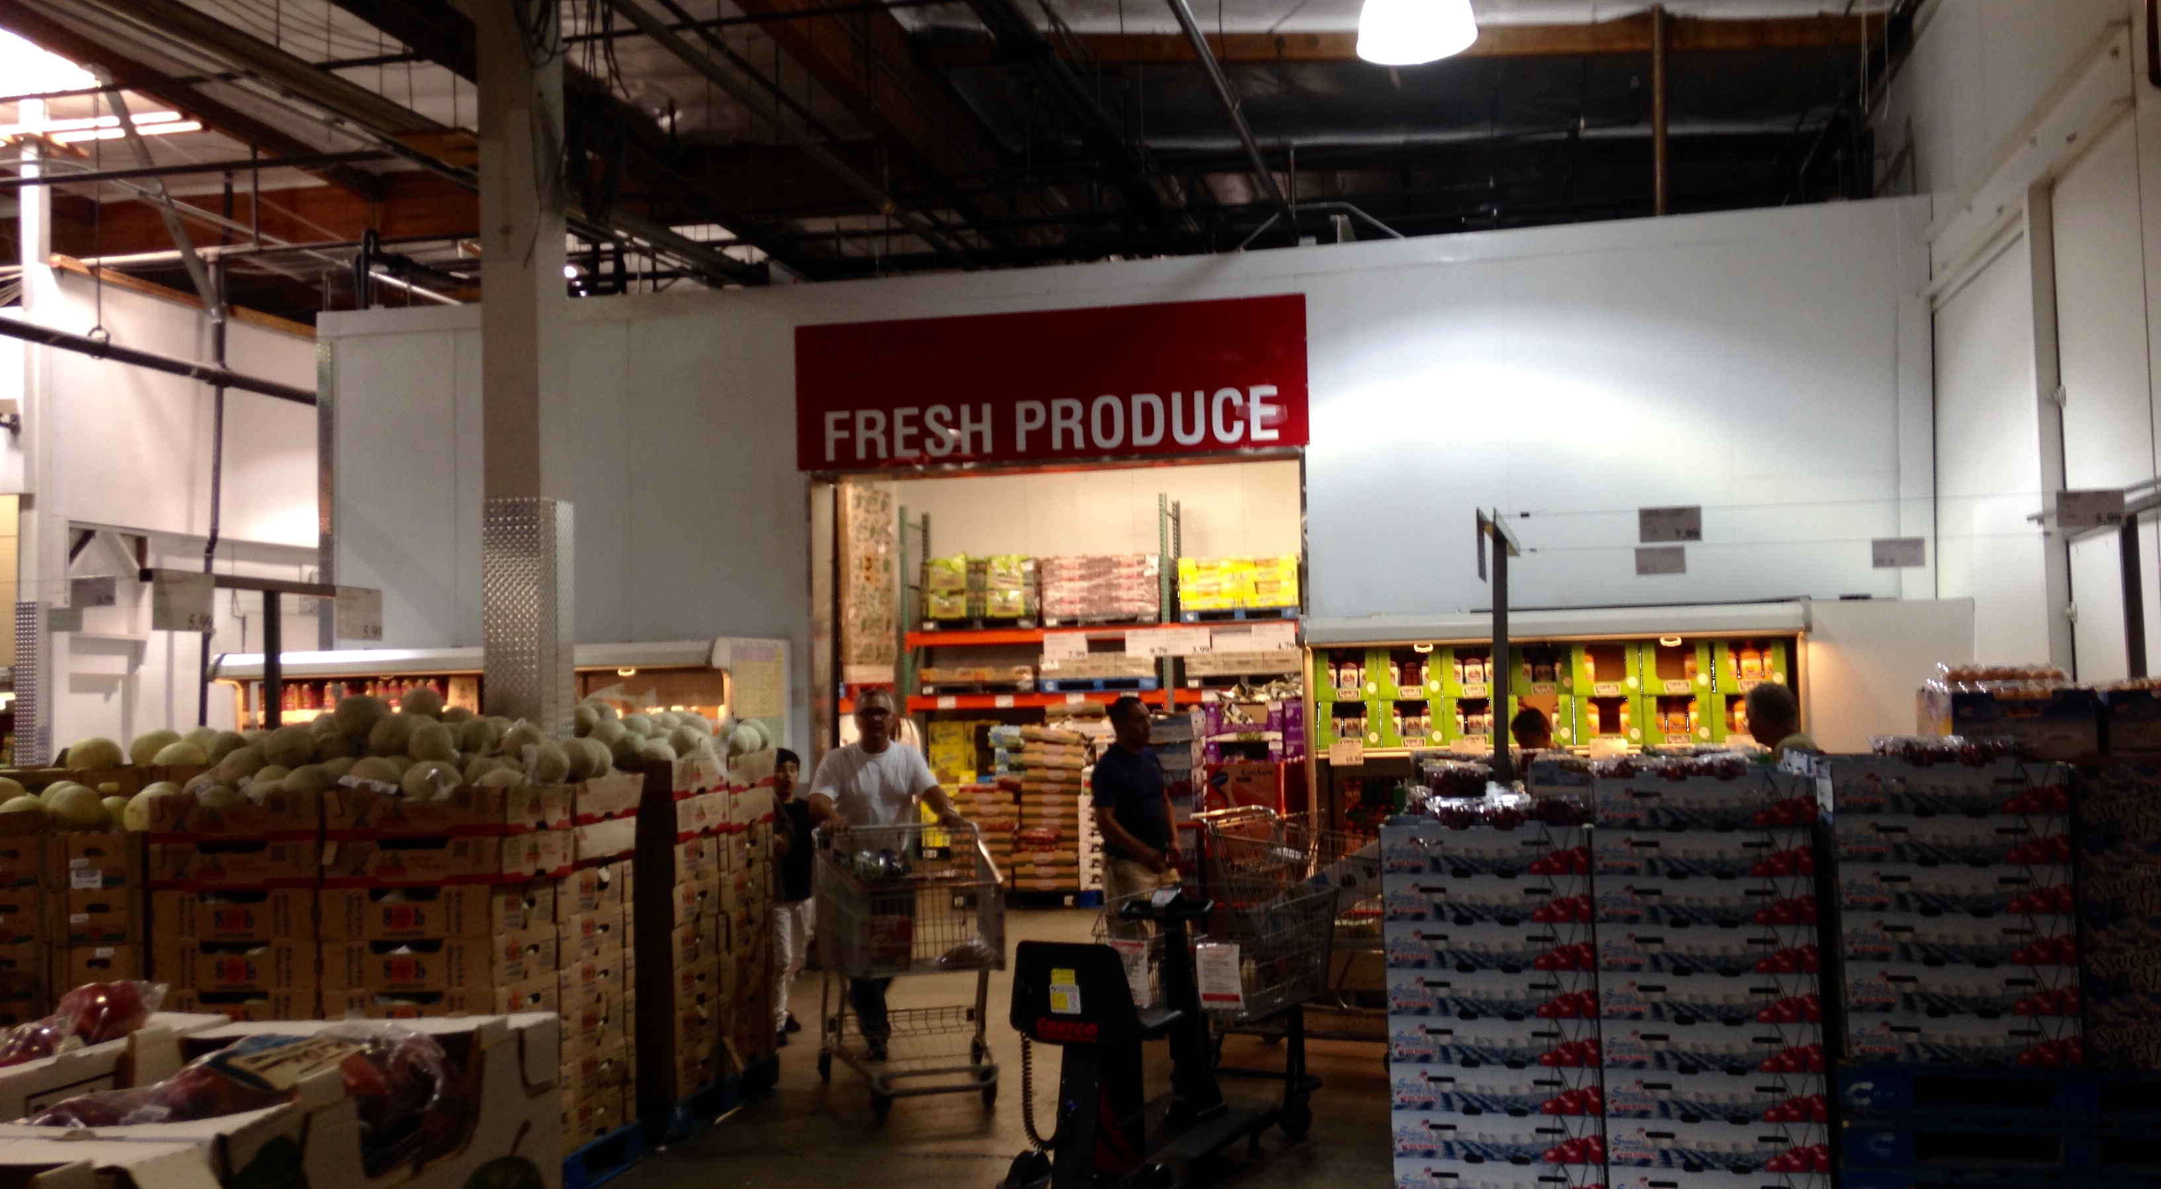
Canoga Park

Slide 9
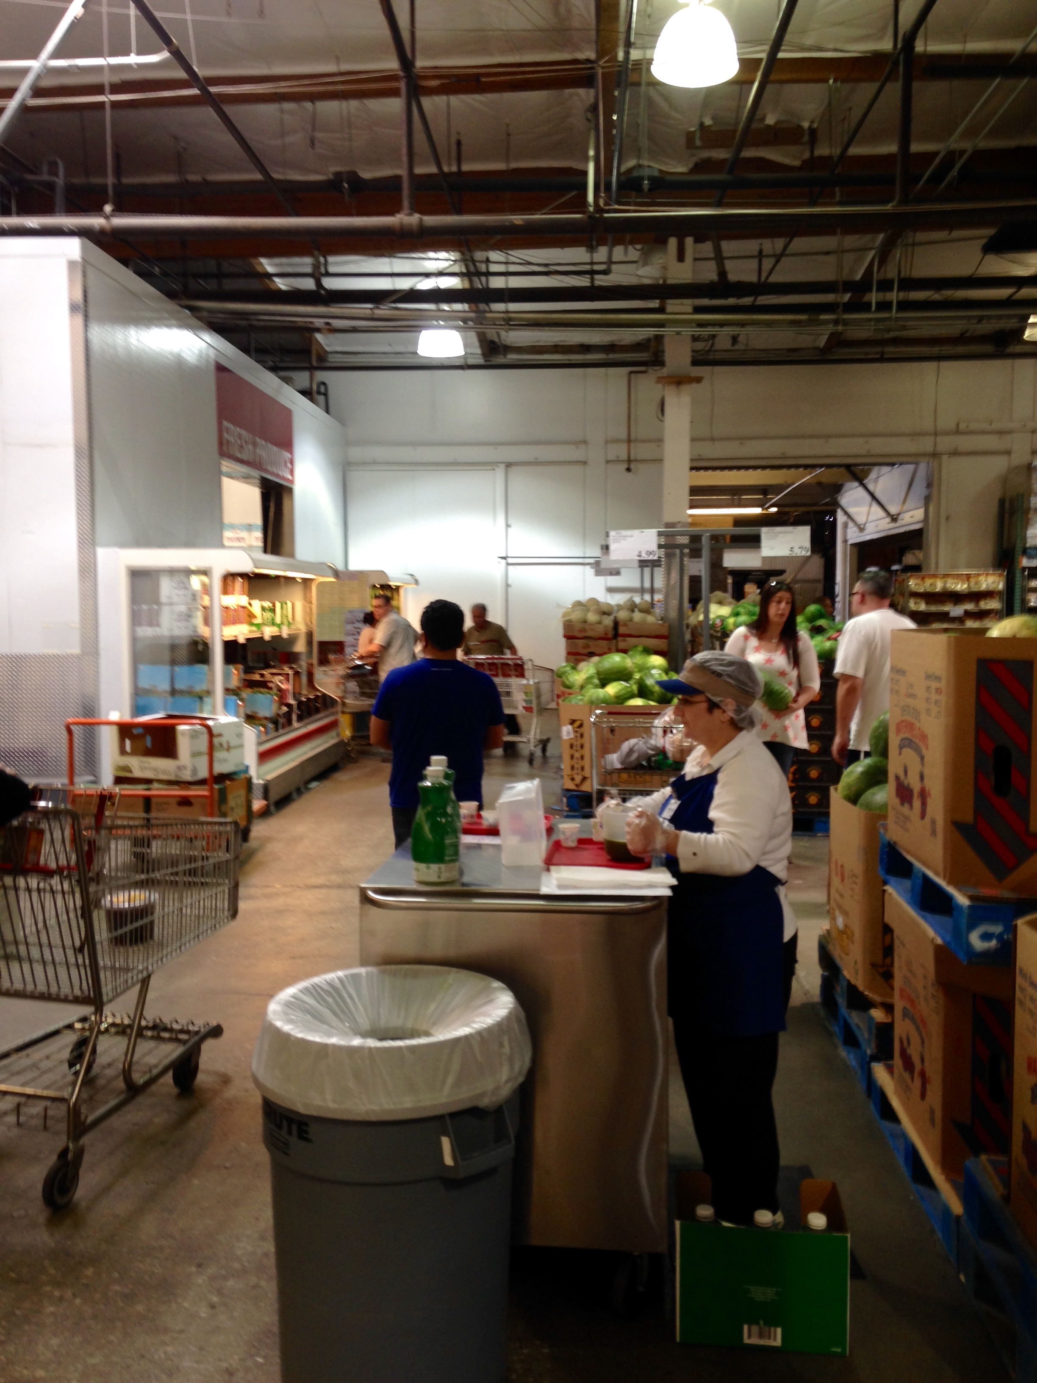
Canoga Park

Slide 10
Westlake Village Costco
5700 Lindero Canyon Rd. Westlake Village, CA 91362
John Peterson w117mer@costco.com & Kristen K. w117mgr3@costco.com
Walk to the back of the store, Dairy coolers are on the left, here would be a great place to set up, putting products in the fridge. Further back is the Produce cooler. Around the side is where the juices are normally kept. Here is my second choice area for demoing, I found a Suja and a Naked juice demo happening across from the juice case in the back of the store. This is also a nice high traffic placement area.

Slide 11
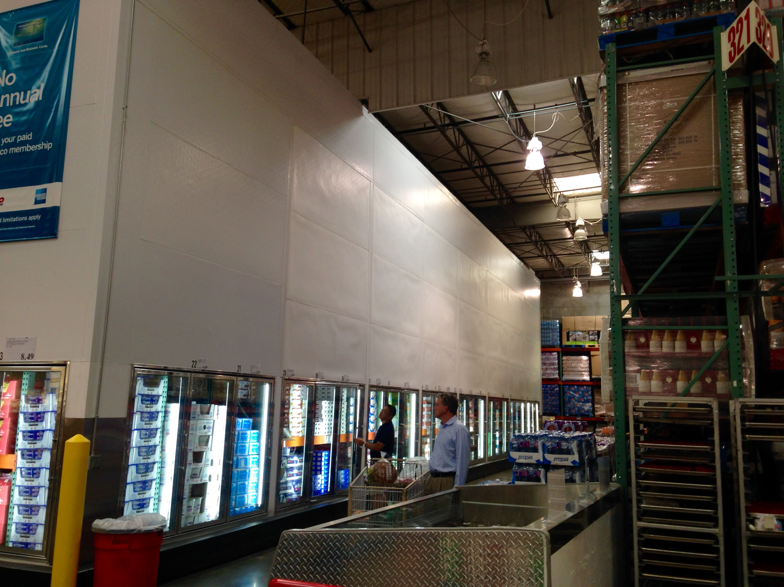
Westlake Village Costco

Slide 12
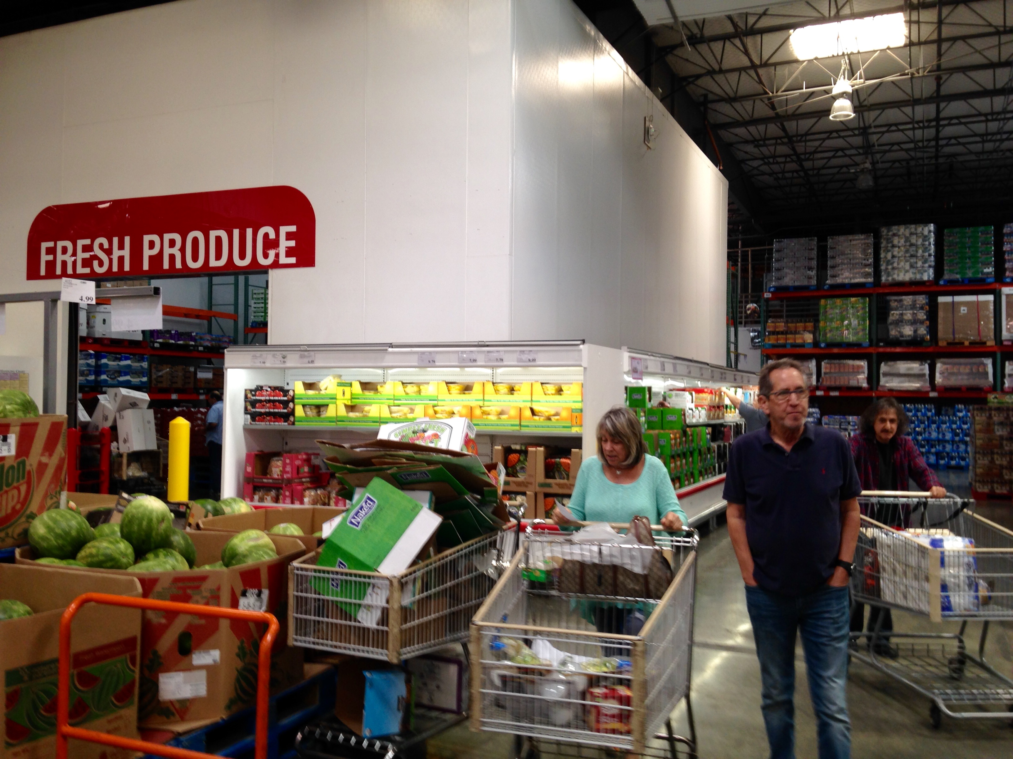
Westlake Village Costco

Slide 13
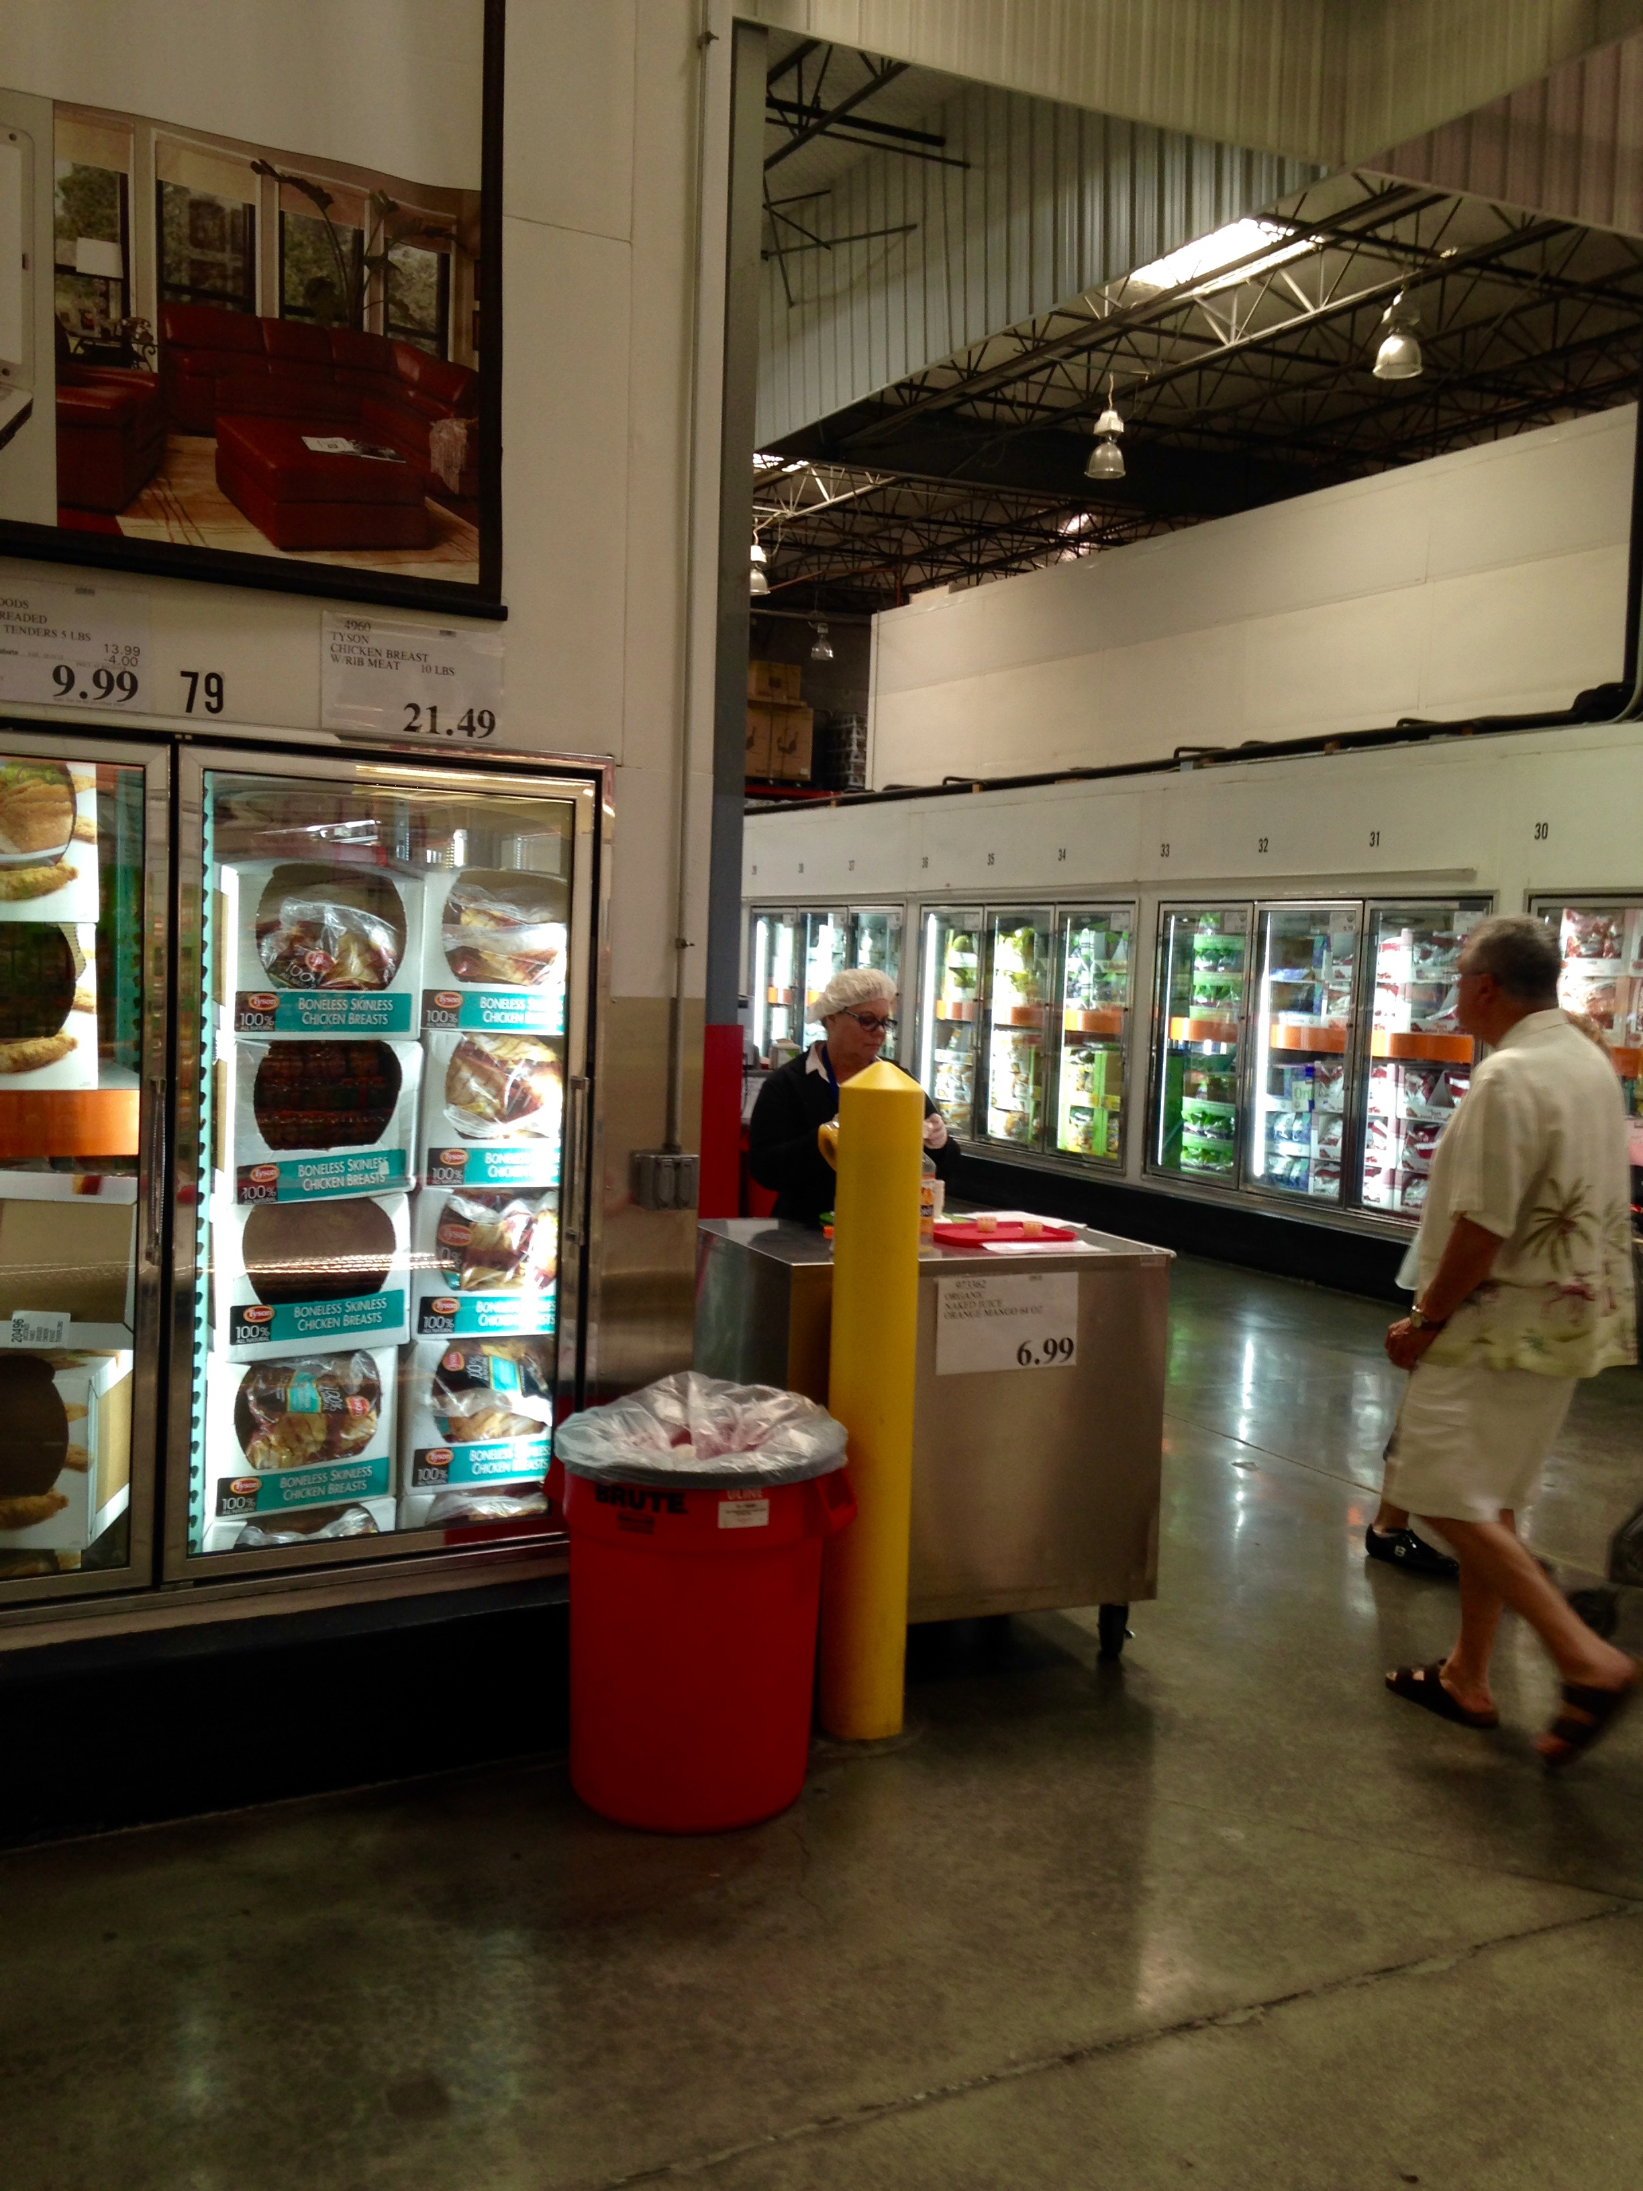
Westlake Village Costco

Slide 14
Simi Valley Costco
2660 Park Center Dr. Simi Valley, CA 93065
Robert Steen w128fd@costco.com
Walk to the back of the store, The Produce and Dairy coolers are connected, the Dairy is around the side. In the back on the side of where the Dairy cooler is, is where the juices are kept. Across from it are fridges. Here would be a great place to set up, putting products in the fridge. I found a Naked juice demo happening across from the juice case in the back of the store. This is another nice placement for demos.

Slide 15
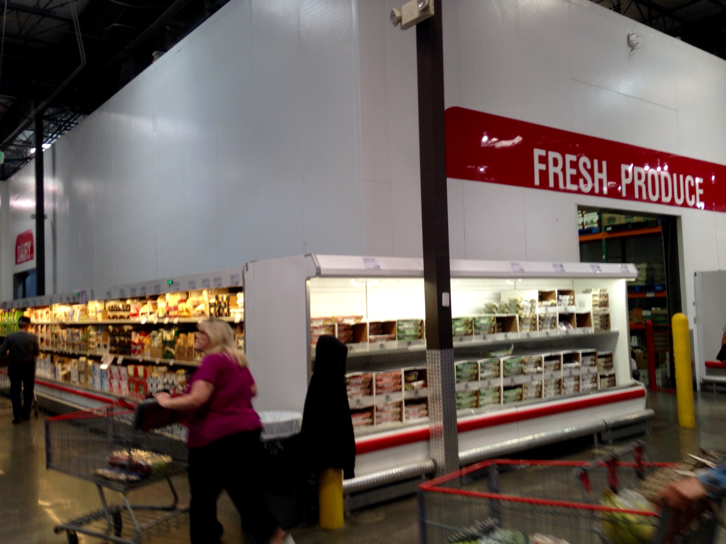
Simi Valley Costco

Slide 16
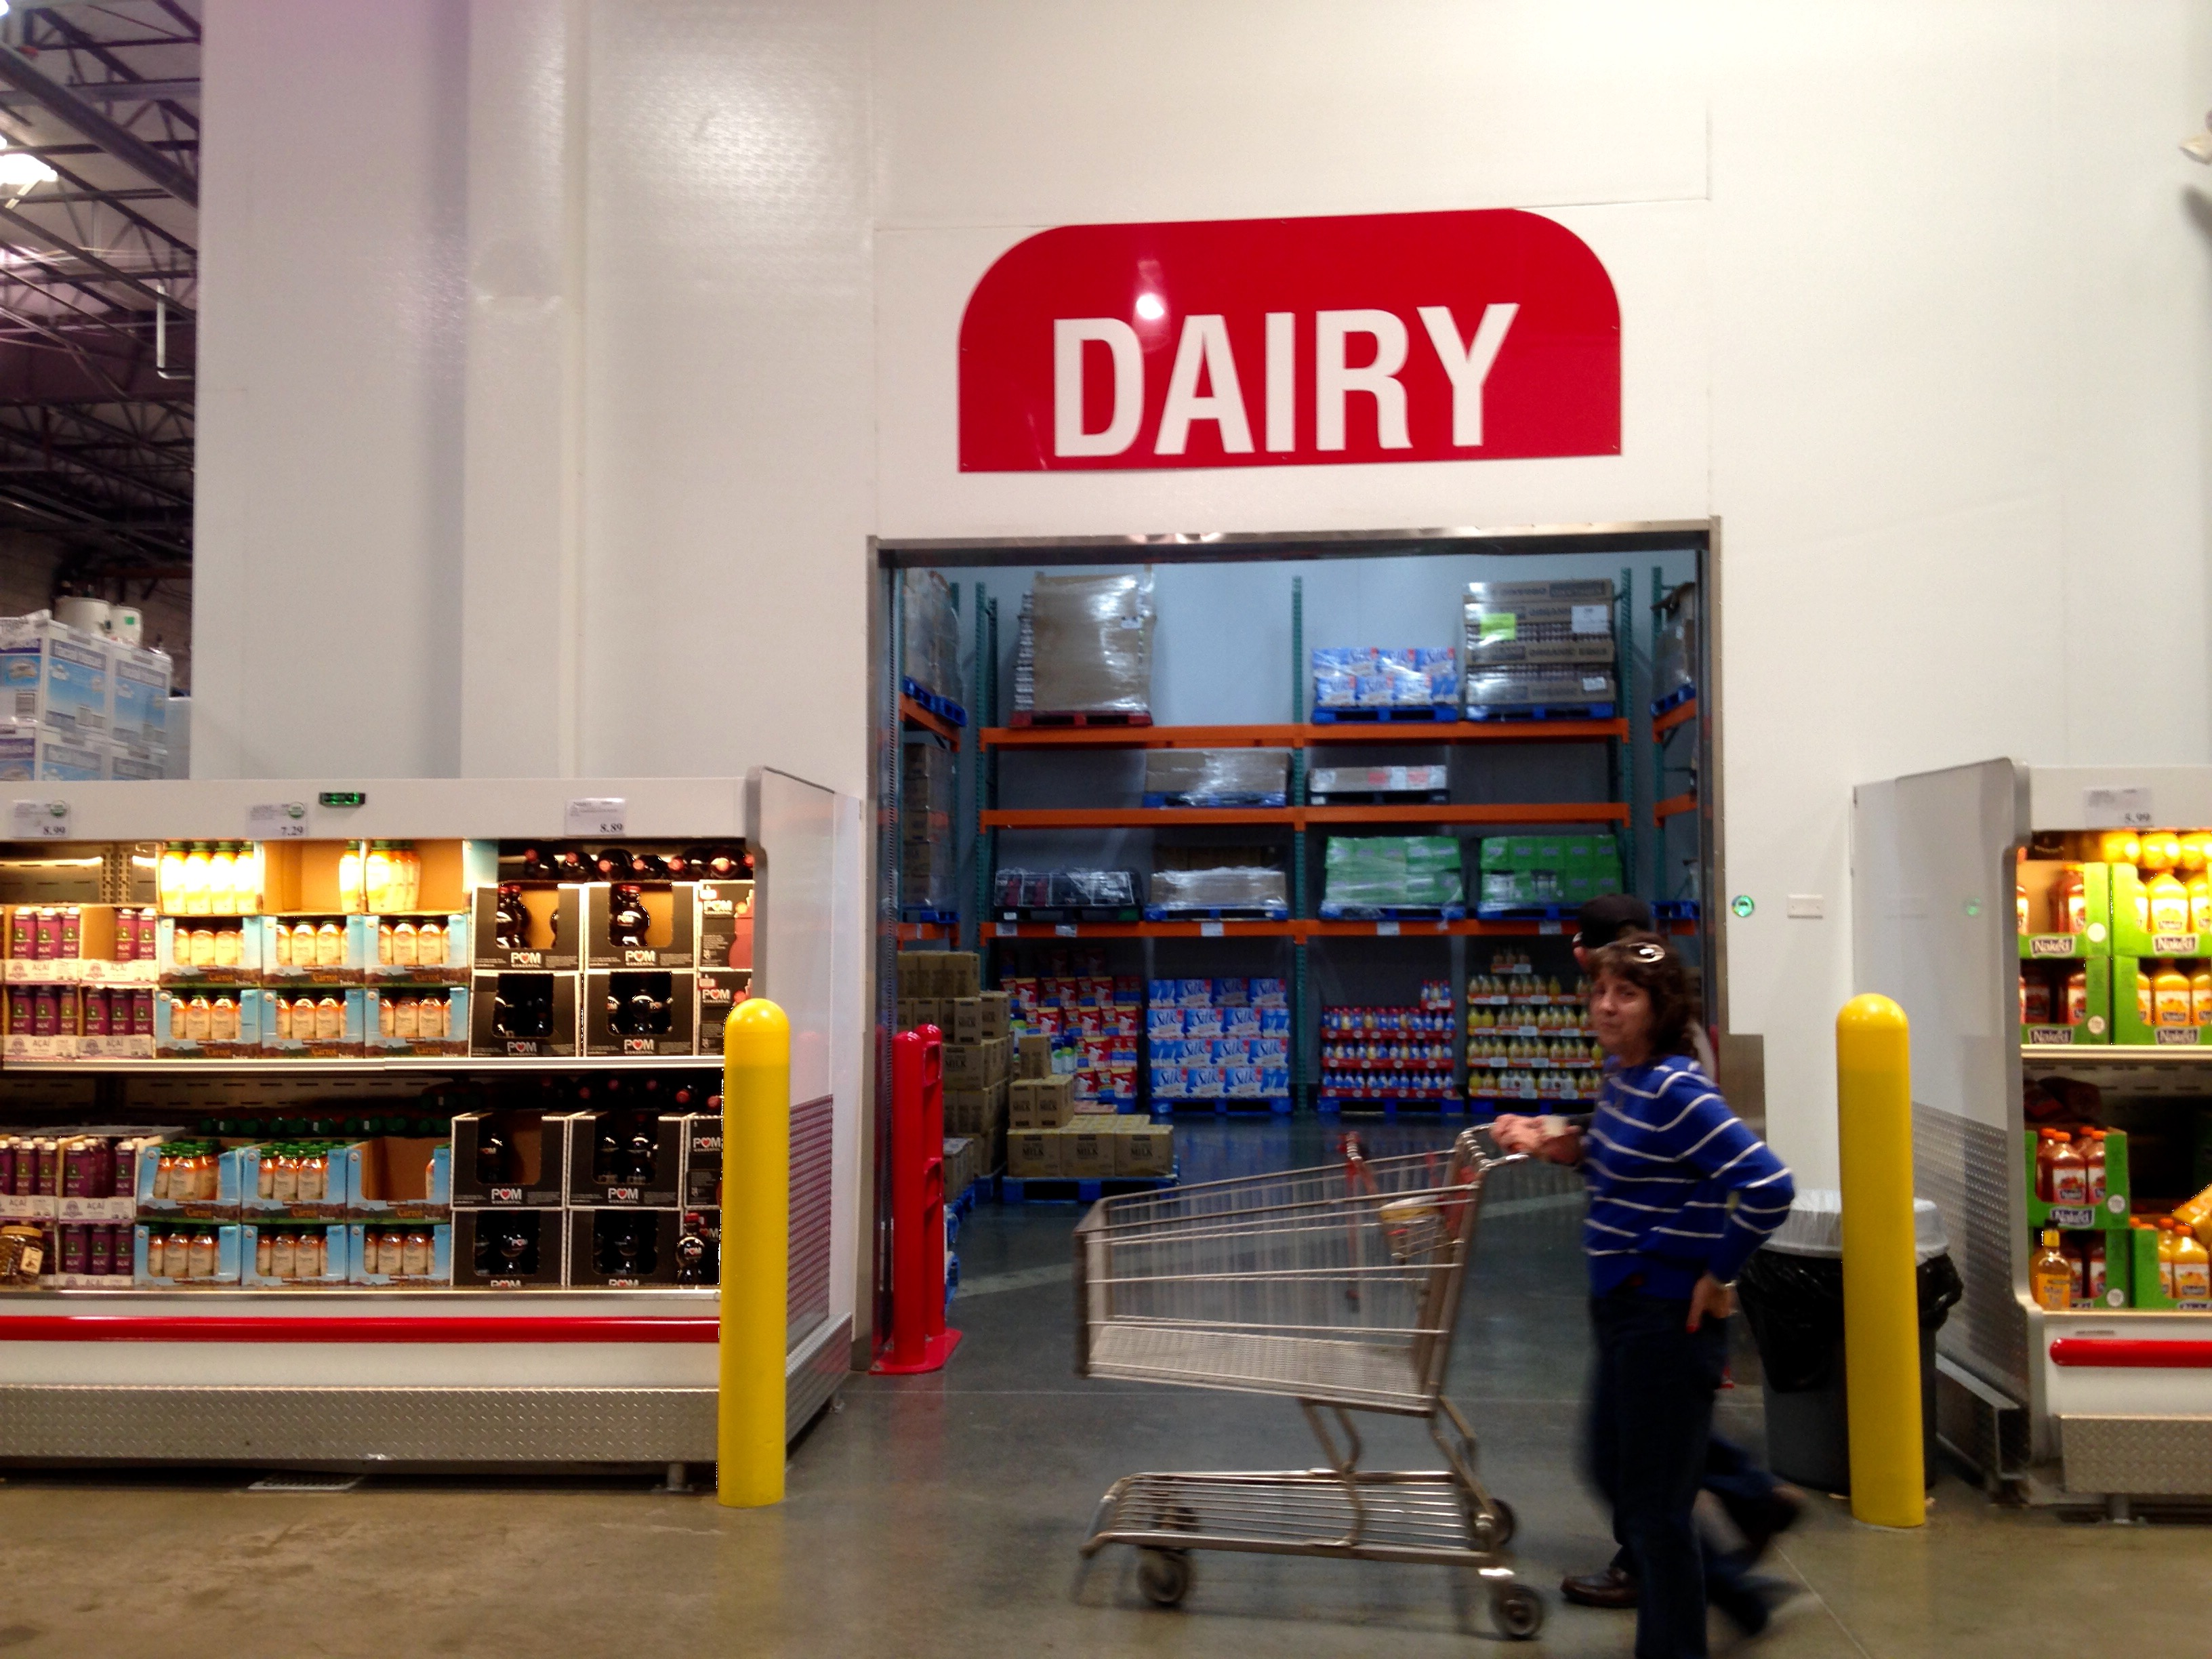
Simi Valley Costco

Slide 17
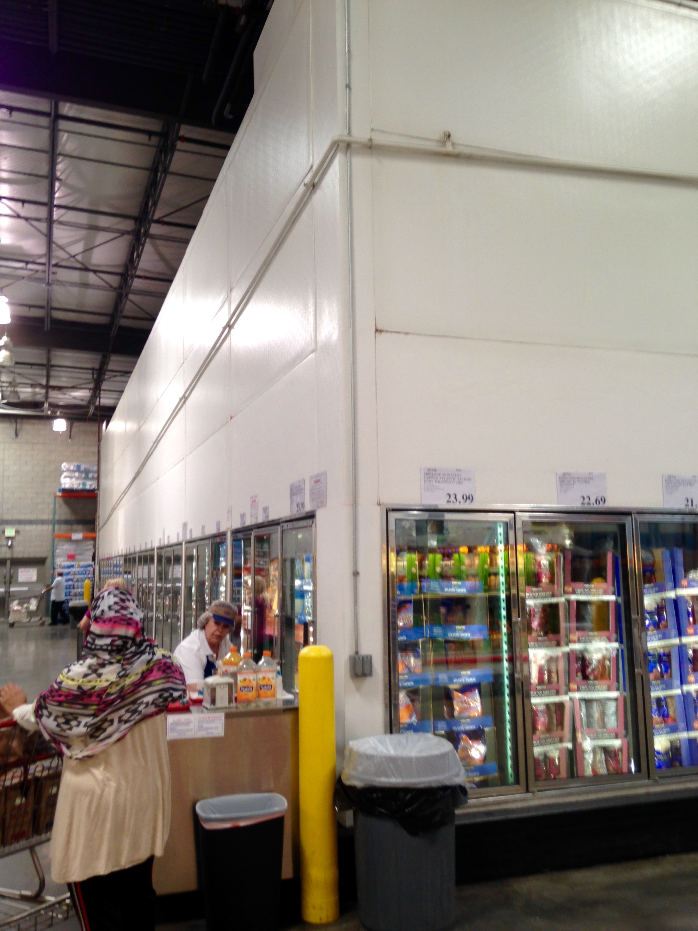
Simi Valley Costco

Slide 18
Pacoima Costco
3550 Paxton St. Pacoima, CA 91331
Larry Gonzalez w01071mer@costco.com, Ray Munoz w01071mgr2@costco.com, Liz Arellano w01071mgr@costco.com
Walk to the back of the store, There are coolers on the side where Naked juice is currently kept. Next to this would be a great place for a demo. Also in the back near the Eggs, Milk and Juice cooler is the case where all the juice is currently kept. Across from this would be another nice placement for a demo.

Slide 19
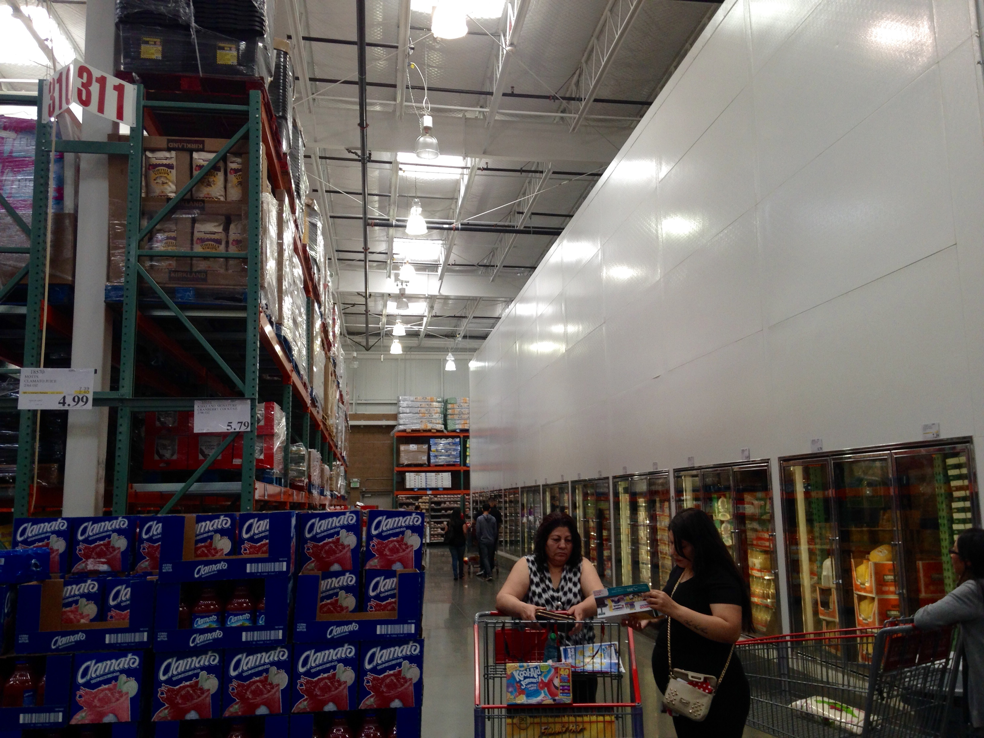
Pacoima Costco

Slide 20
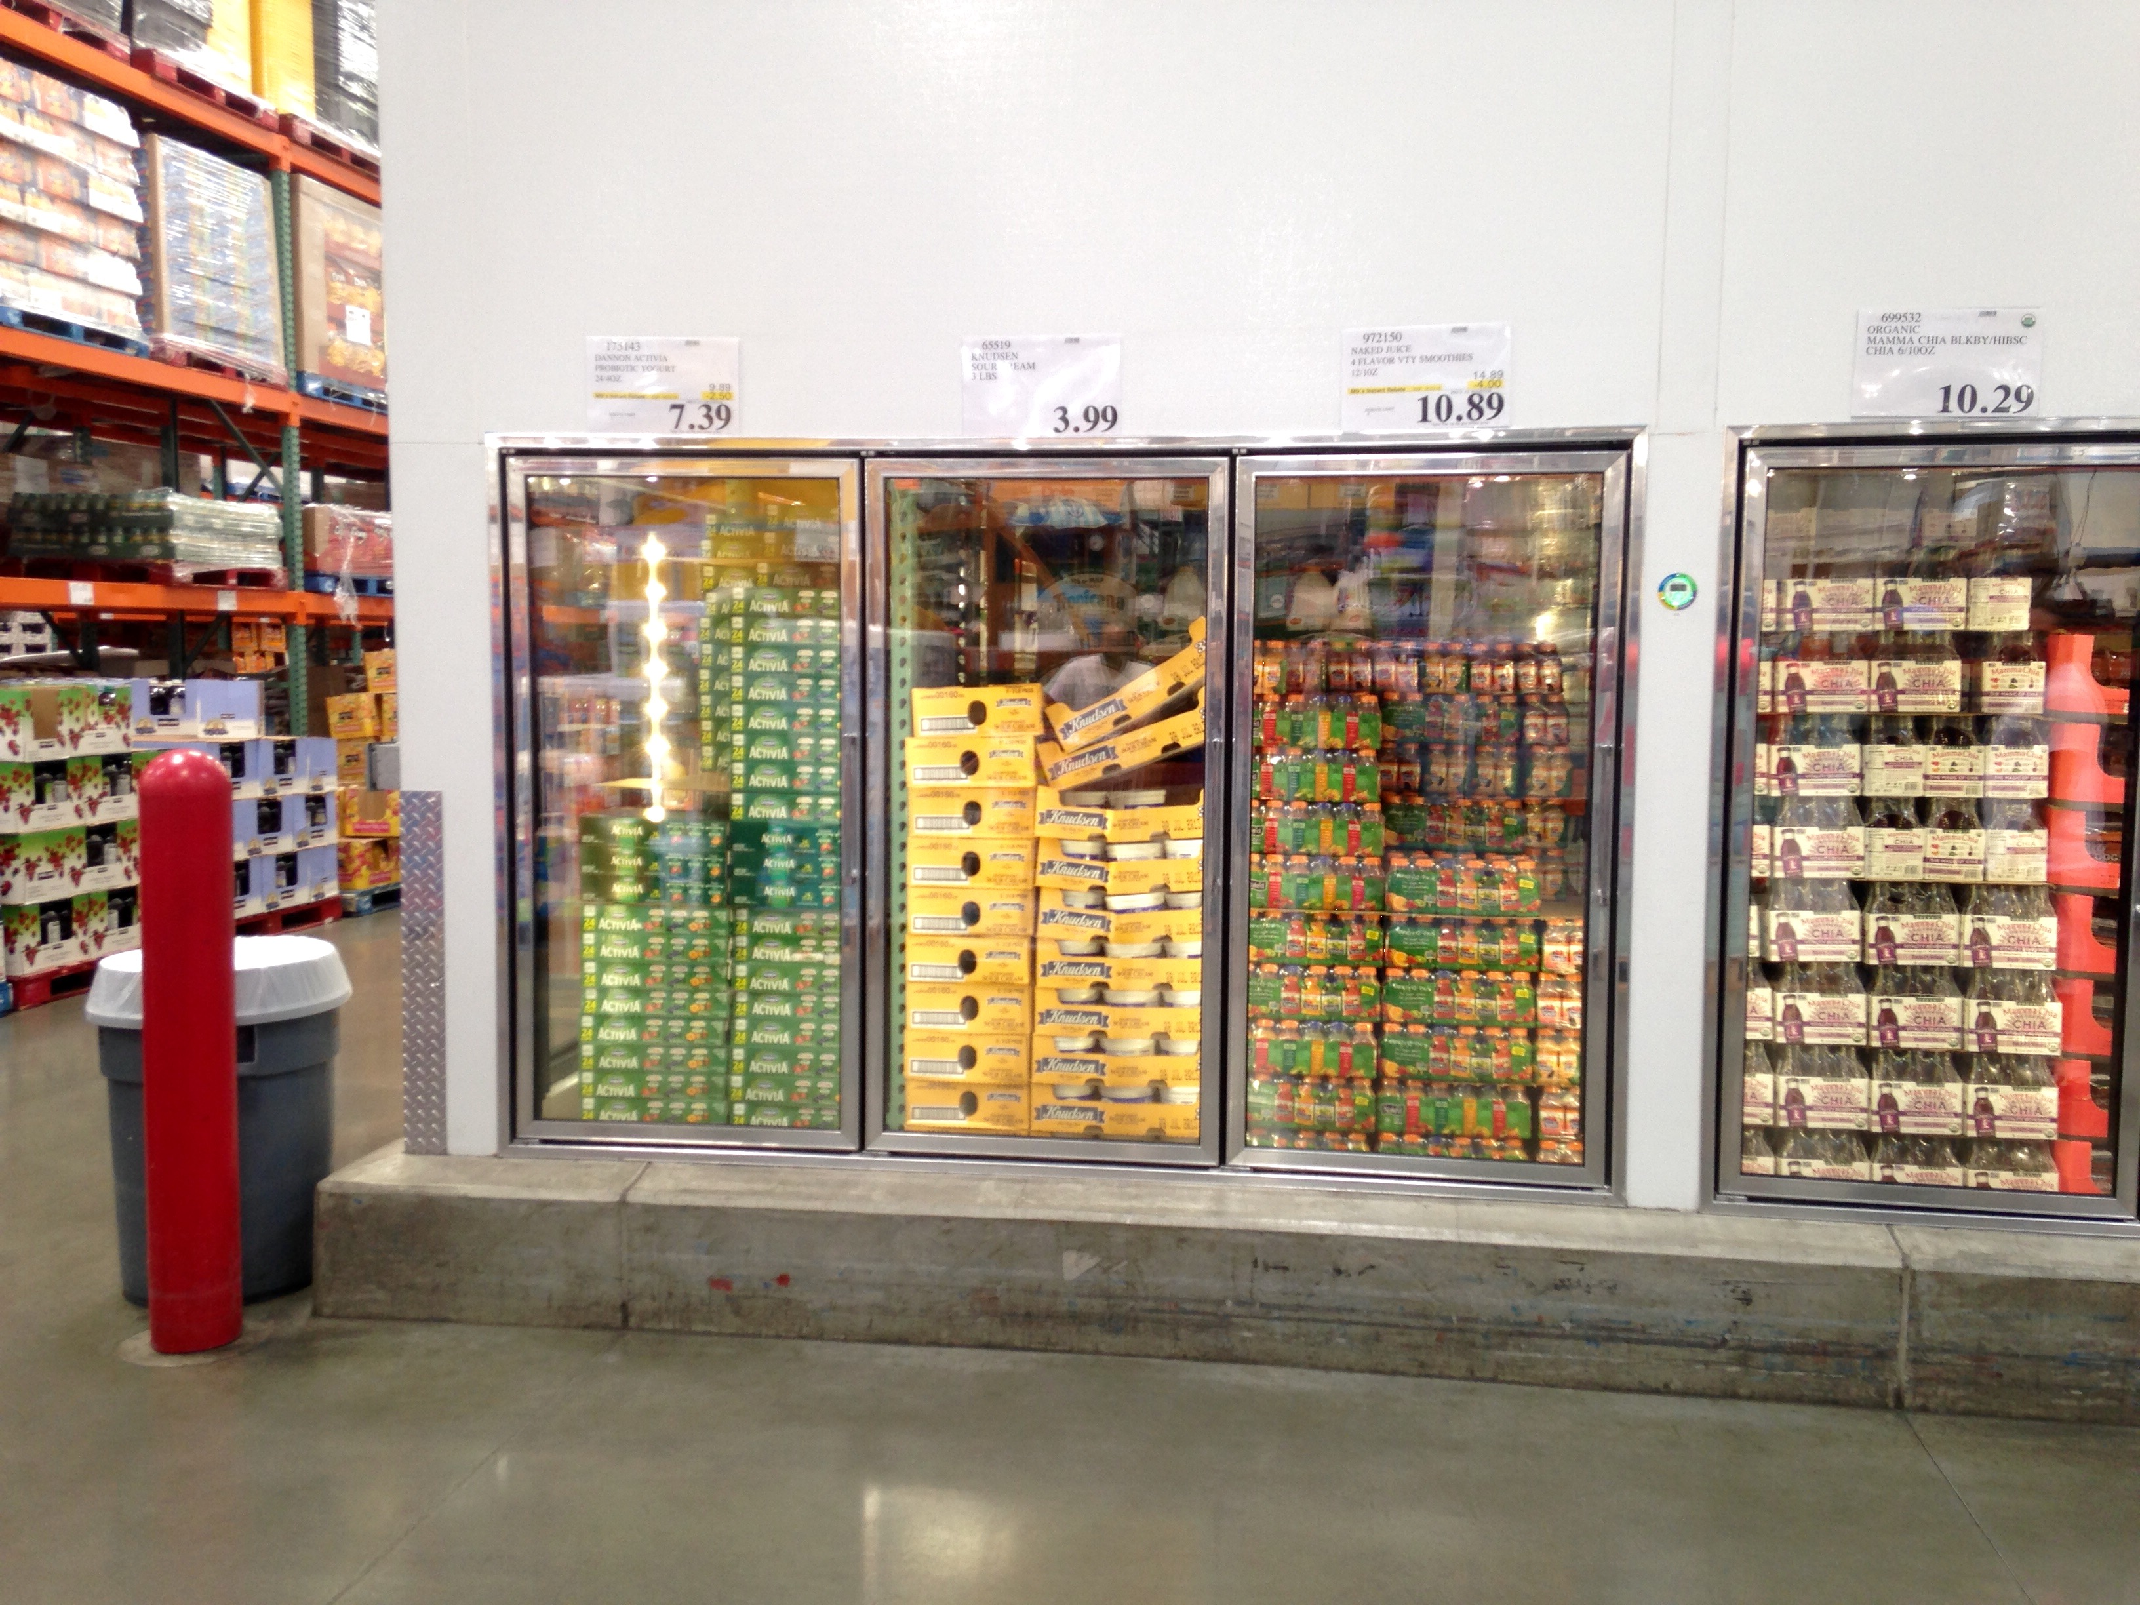
Pacoima Costco

Slide 21
Pacoima Costco

Slide 22
Santa Clarita Costco
18649 Via Princesa Santa Clarita, CA 91387
Elizabeth Cogan w447mer@costco.com
Walk to the back of the store, There are coolers on the side. I ran into a Suja demo here. This would be a great place for a demo. Also in the back around the side of the Produce cooler is the case where juices are normally kept. A secondary placement could be in the aisles across from this case.

Slide 23
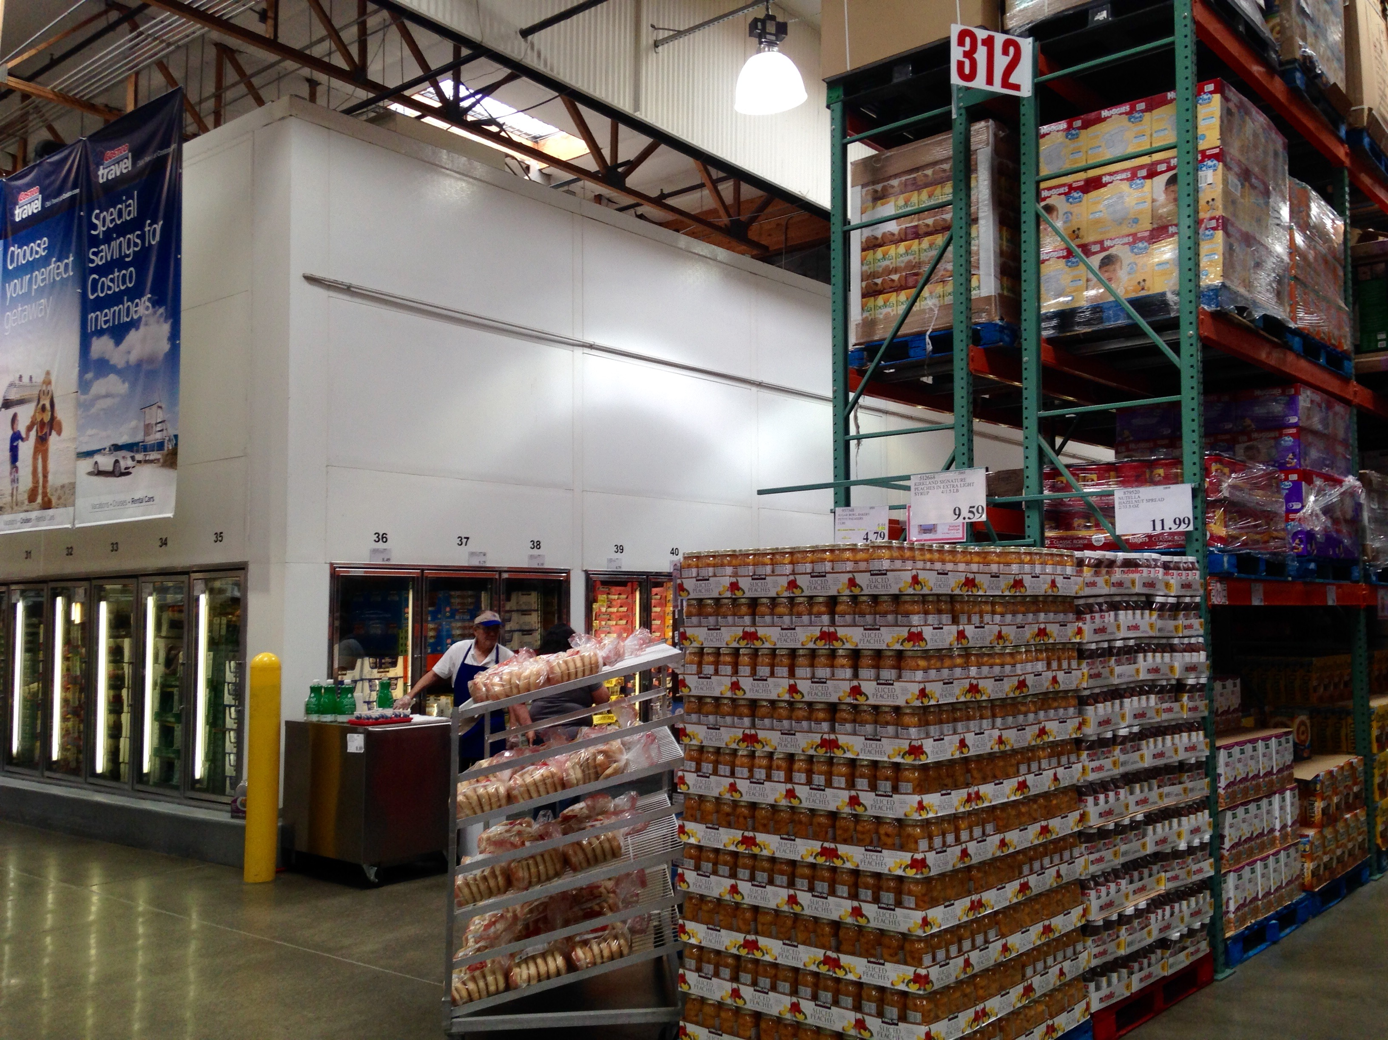
Santa Clarita Costco

Slide 24
Santa Clarita Costco

Slide 25
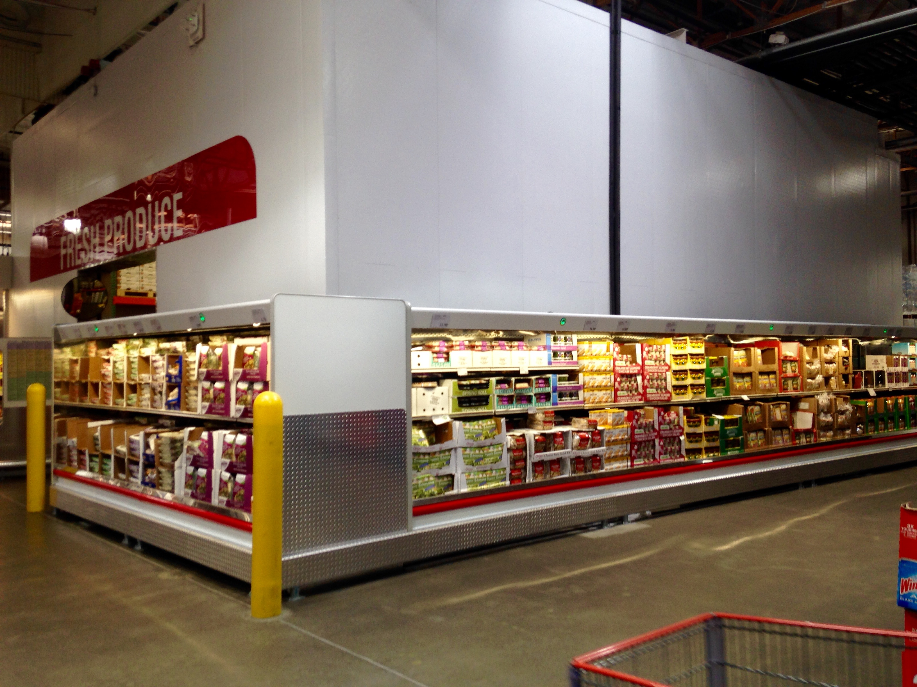
Santa Clarita Costco

Slide 26
Lancaster Costco
1141 W Avenue L Lancaster, CA 93534
Debbie Swift w762mer@costco.com
Walk to the back of the store, There are coolers on the side. This would be a great place for a demo. Also in the back around the side of the Produce cooler is the case where juices are normally kept. A secondary placement could be in the aisles across from this case.

Slide 27
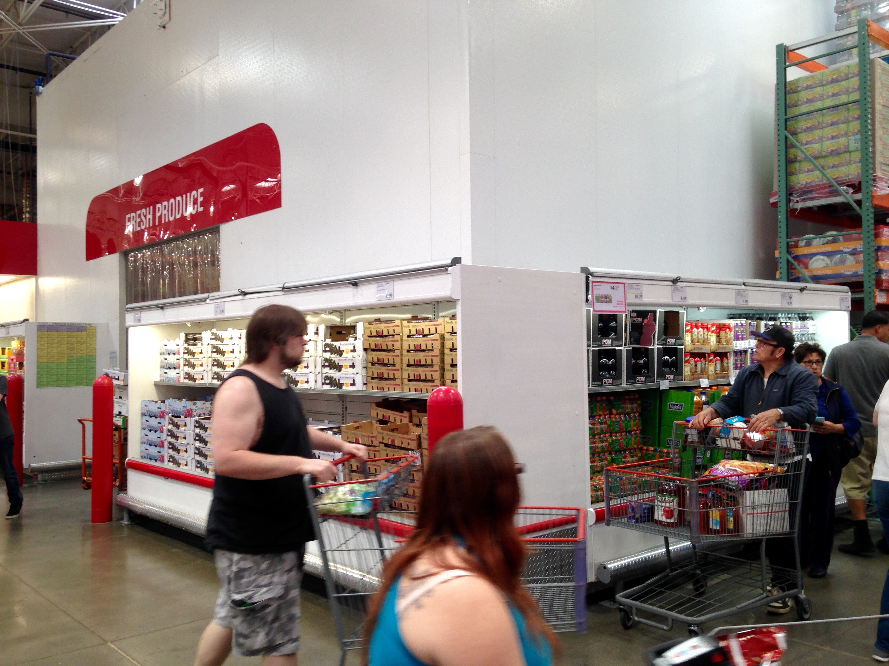
Lancaster Costco

Slide 28
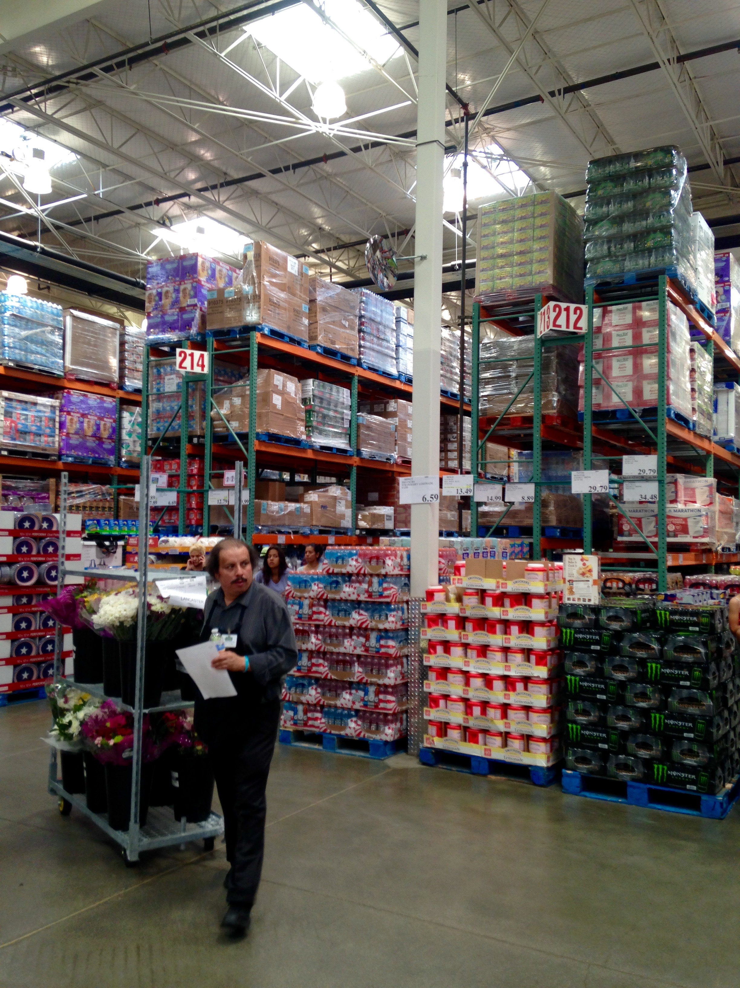
Lancaster Costco

Slide 29
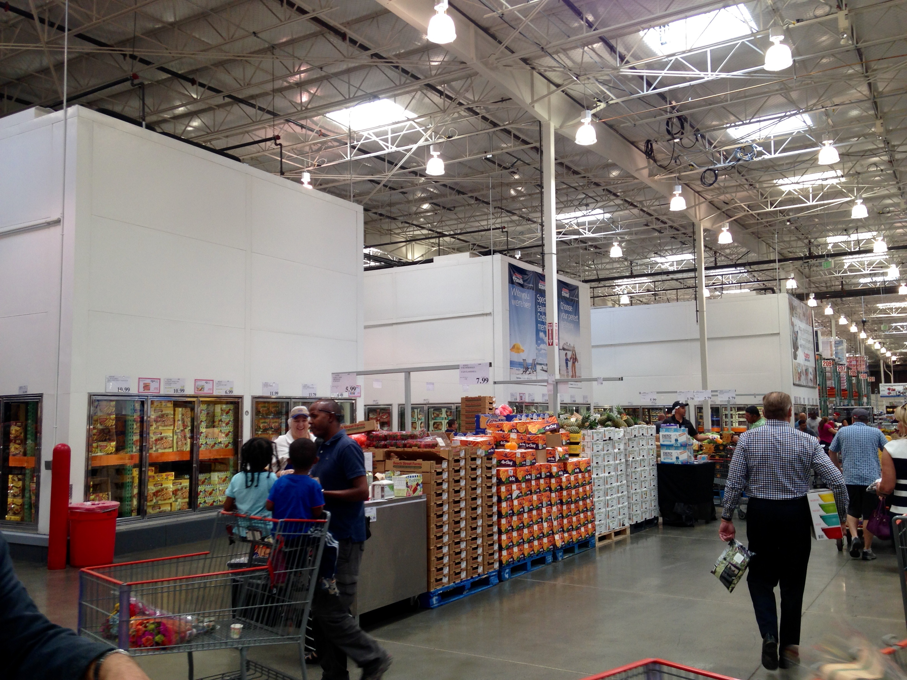
Lancaster Costco

Slide 30
Alhambra Costco
2207 W Commonwealth Ave. Alhambra, CA 91803
Ryan Dunkle w428mer@costco.com
Walk to the back of the store, There are coolers on the side. This would be a great place for a demo. Also in the back around the side of the Produce cooler. A secondary placement could be in the aisles across from this case.

Slide 31
Alhambra Costco

Slide 32
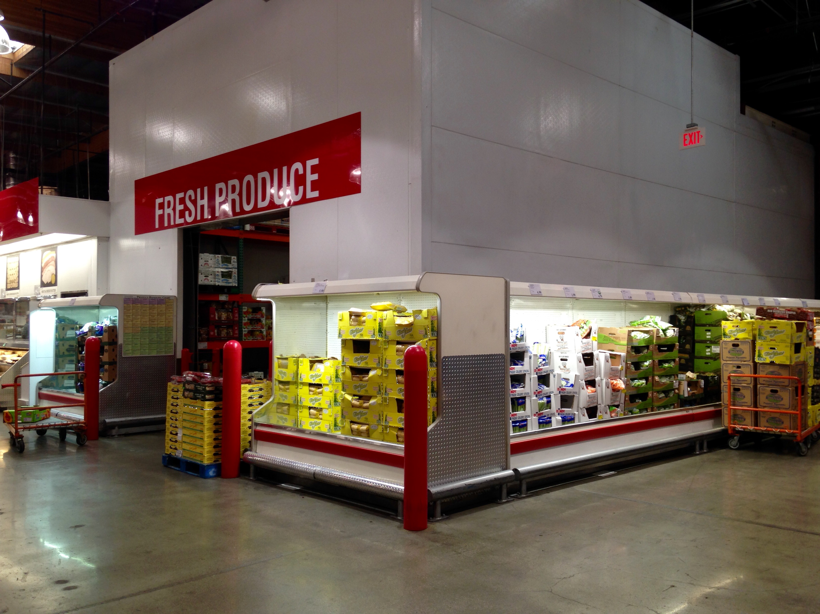
Alhambra Costco

Slide 33
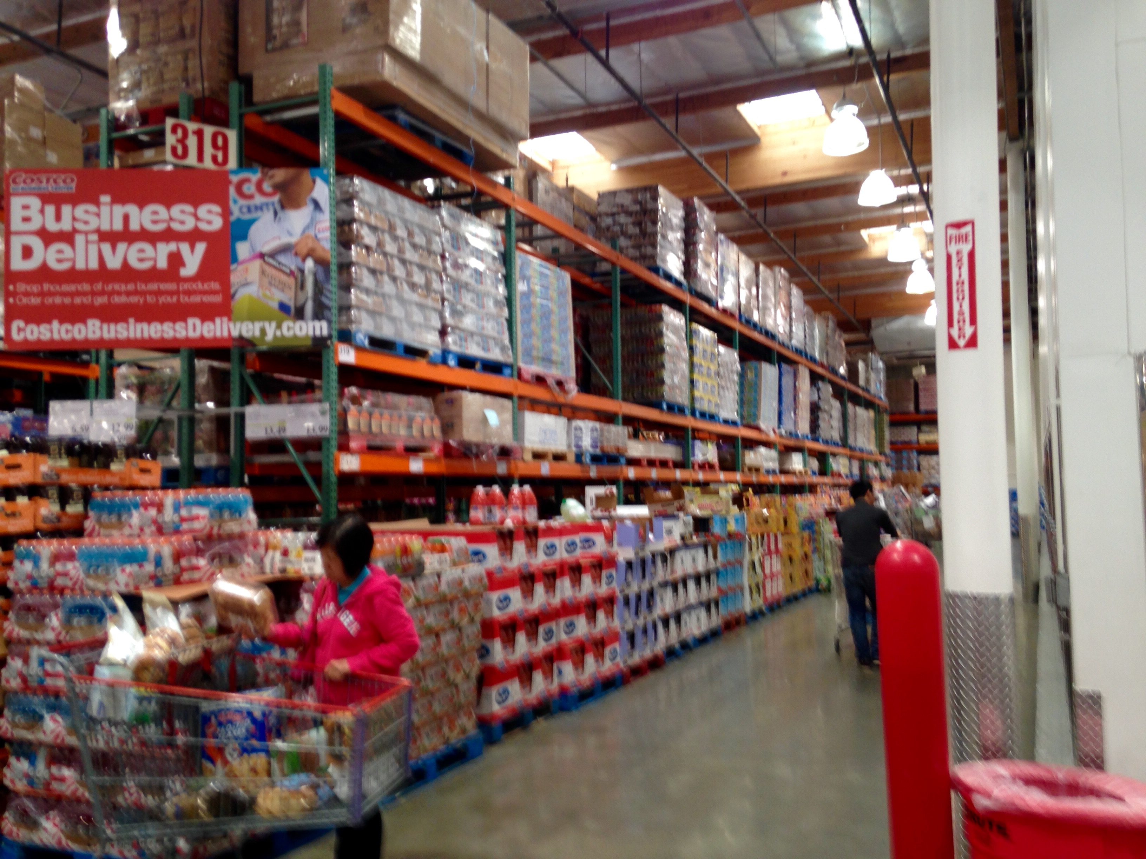
Alhambra Costco

Slide 34
Montebello Costco
1345 Montebello Blvd. Montebello, CA 90640
Mike Valle w459mer@costco.com
Walk to the back of the store, There are coolers on the right side. This would be a great place for a demo. Also in the back around the side of the Produce cooler. A secondary placement could be in the aisles across from this case.

Slide 35
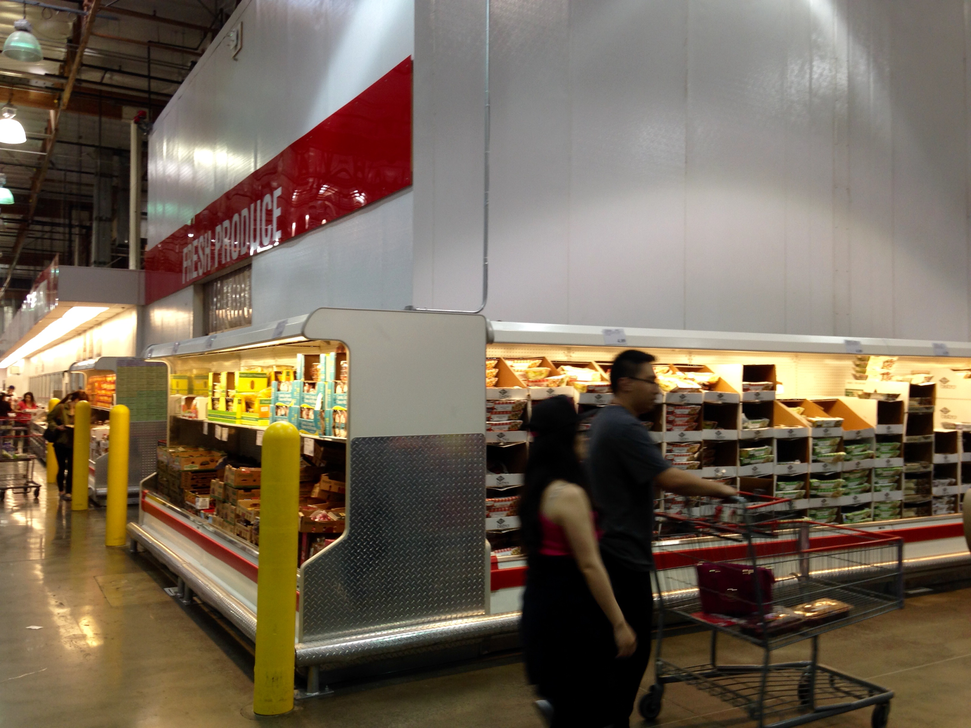
Montebello Costco

Slide 36
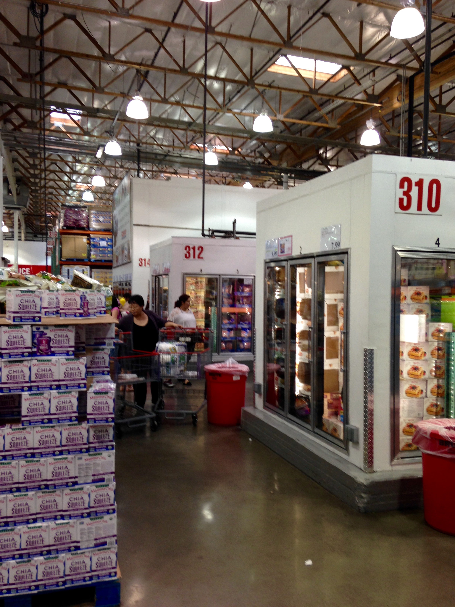
Montebello Costco

Slide 37
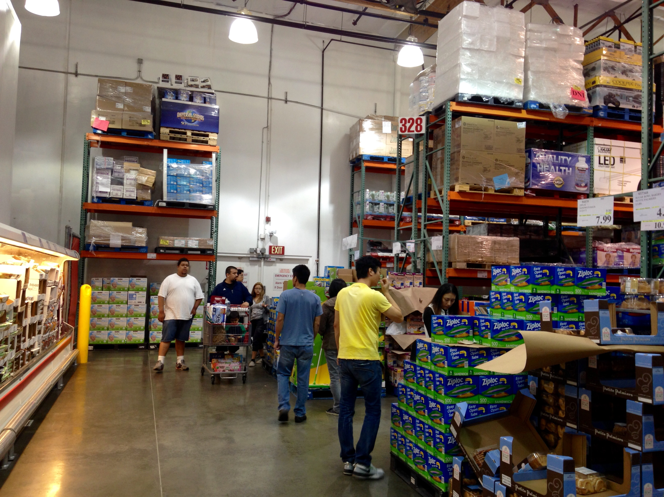
Montebello Costco

Slide 38
La Habra Costco
101 N Beach Blvd. La Habra, CA 90631
Carlos Diaz w777mer@costco.com
Walk to the back of the store, There are coolers on the right side. This would be a great place for a demo. Also in the back around the side of the Produce cooler. A secondary placement could be in the aisles across from this case.

Slide 39
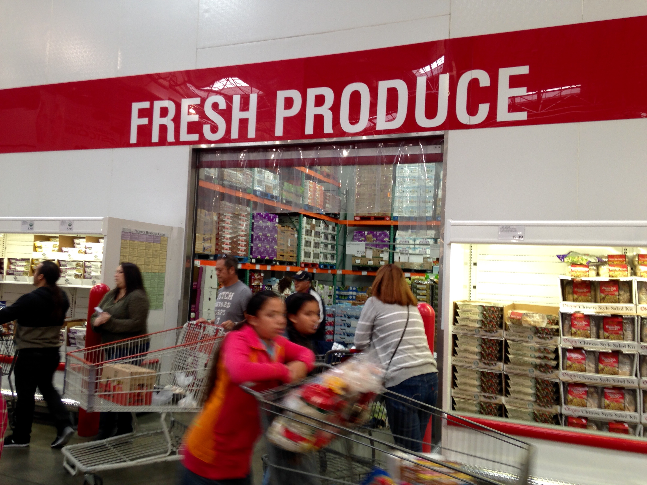
La Habra Costco

Slide 40
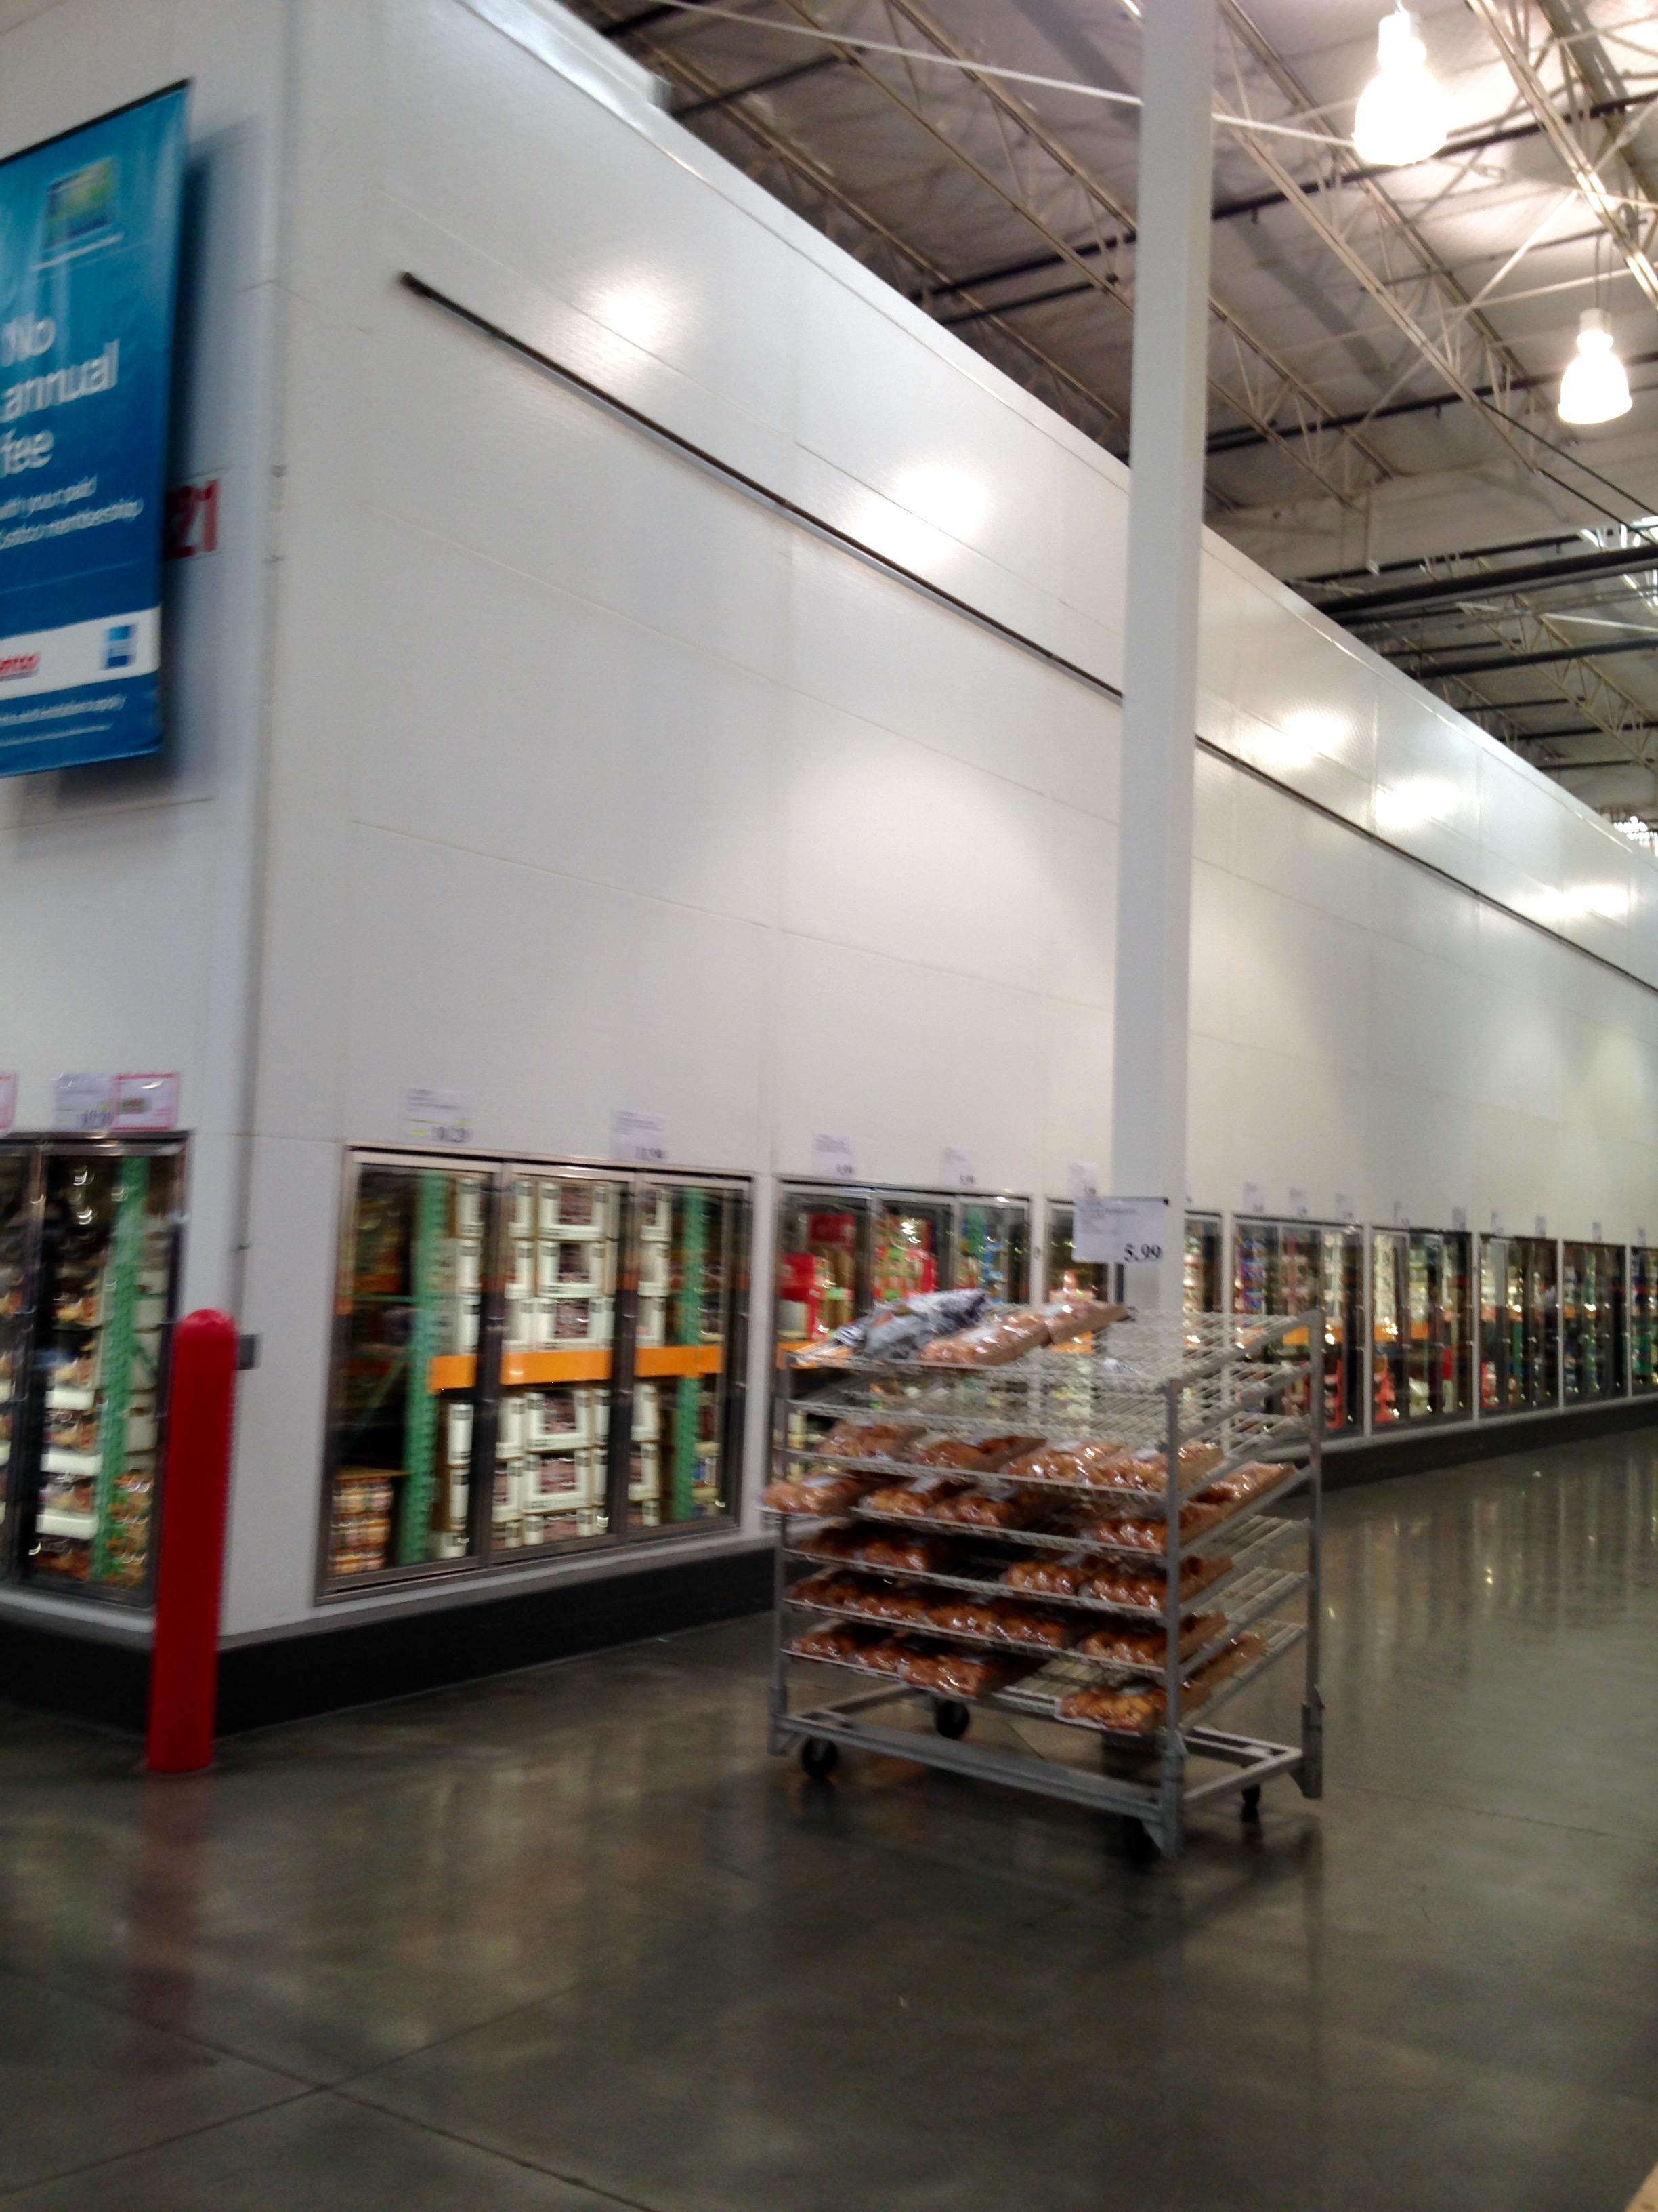
La Habra Costco

Slide 41
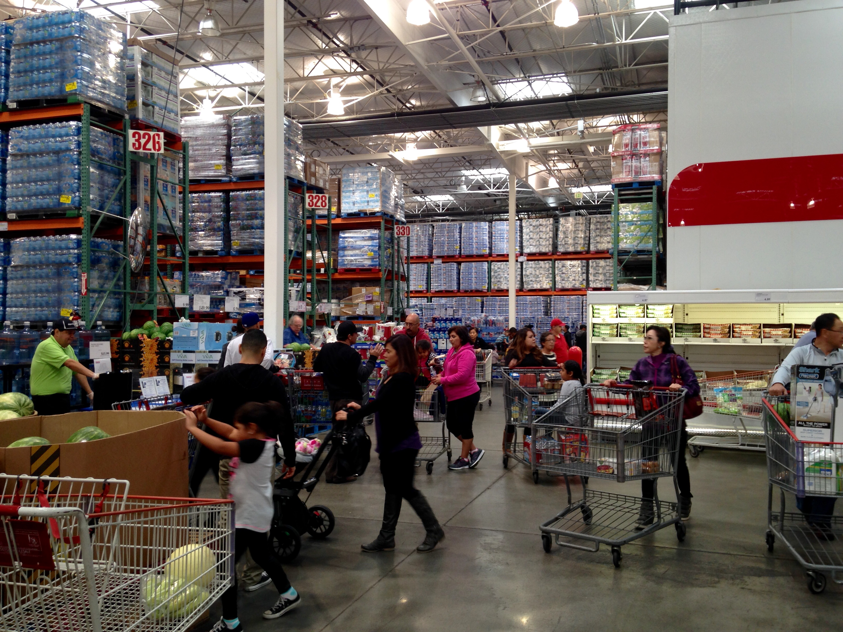
La Habra Costco

Slide 42
WTRMLN WTR
Thank you!
For questions and concerns, please contact Kelly Kalac
323-872-6512
kkalac001@gmail.com

